Slide 1
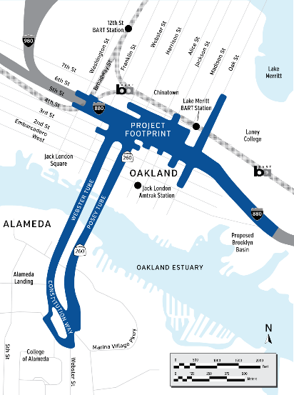
Oakland Alameda Access Project
Providing Access and Connections

Slide 2
Project Purpose and Need
Improve multimodal safety and reduce conflicts between regional and local traffic
Enhance bicycle and pedestrian accessibility and connectivity within the project study area
Improve mobility and accessibility for travelers between I-880, SR-260, City of Oakland downtown neighborhoods, and the City of Alameda
Reduce freeway-bound regional traffic and congestion on local roadways and in area neighborhoods

Slide 3
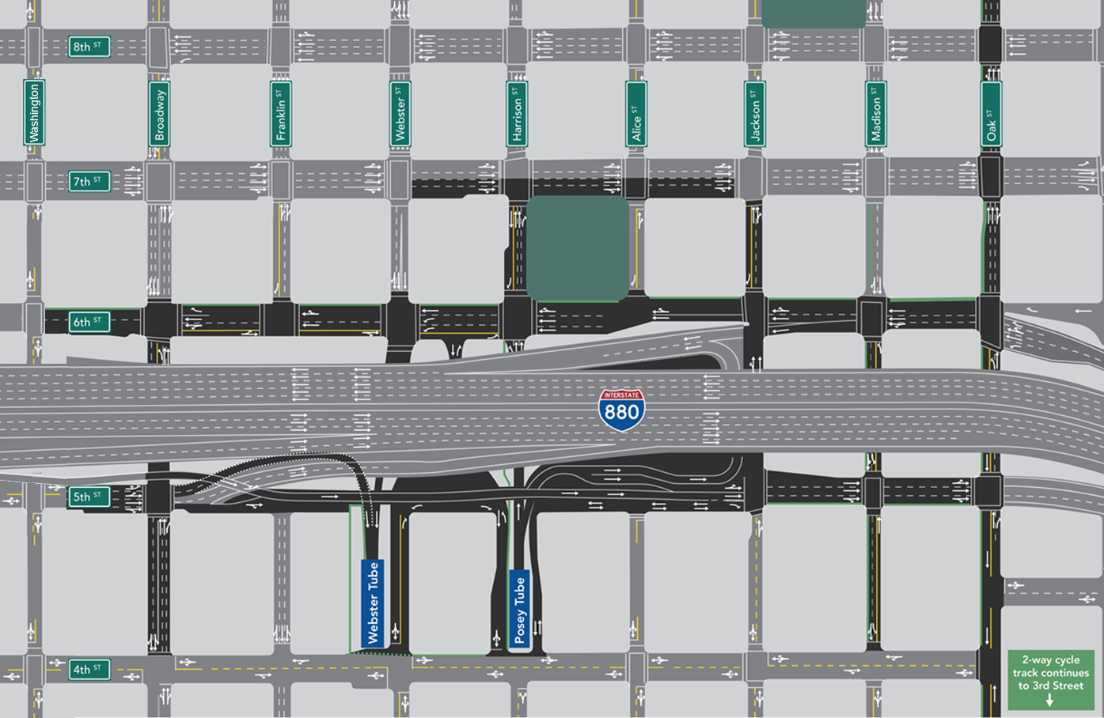

Major Roadway Improvements
CHINATOWN
7
2-way cycle track continuous to 9th St
1
Realign WB I-980 Jackson St off-ramp and reconstruct 5th St
2
Construct right-turn from Posey Tube onto Horseshoe to NB Jackson St on-ramp
4
3
Widen NB I-880 Oak off-ramp, remove NB I-880 Broadway off-ramp, reconstruct 6th St for multi-modal access (Oak St to Washington St)
Oakland
Police
8 Orchid
Salvation Army
Chinese
Garden
Park
3
4
Restripe 7th St and improve intersections
8
6
5
Restripe Madison
for 2-way travel between 4th to 6th St
NORTH
5
SOUTH
6
Restripe Jackson for 1-way
between 5th to 6th
8
1
7
Restripe Oak St
for multimodal access
(2-way cycle track from 3rd to 9th St)
428
Alice
2
8
Reconfigure intersections at Broadway and 6th and 5th St
JACK LONDON DISTRICT
2-way cycle track continuous to 3rd St
3
Notes:
A major overhaul of the roadway infrastructure is necessary to achieve the project purpose.
In particular, improvement #2 by creating a more direct access from vehicles leaving the Posey tube and bound for 880 North and improvement #3 which includes the removal of the I-880 Broadway off ramp, significant opportunities are available to drastically improve pedestrian safety on the local streets.

Slide 4
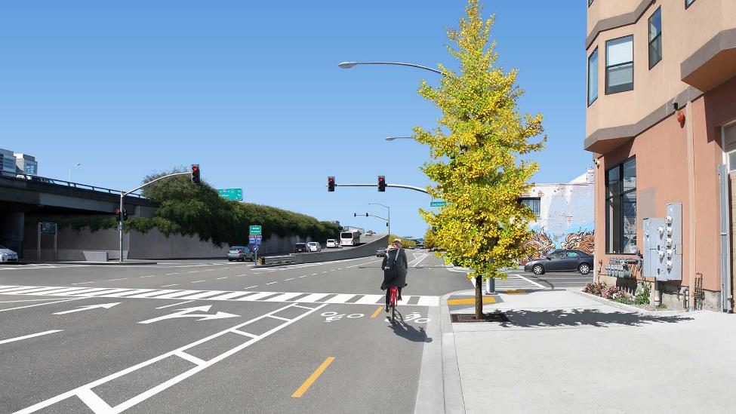
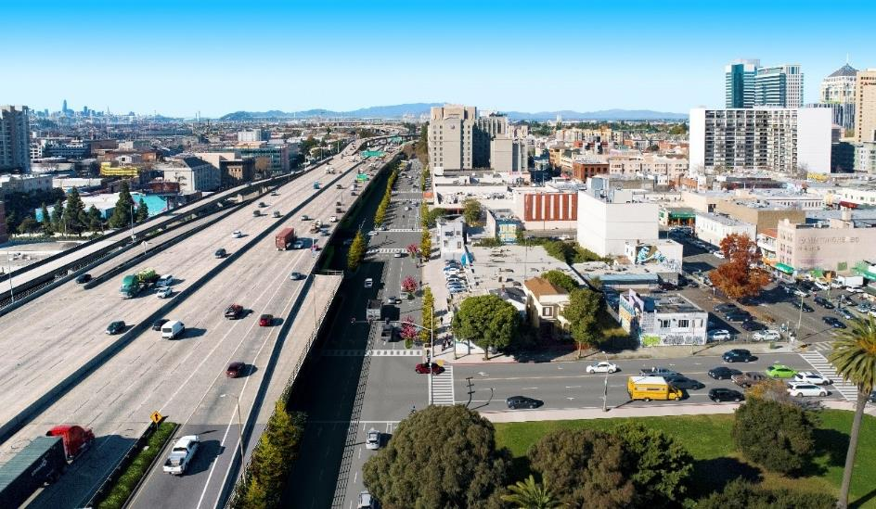
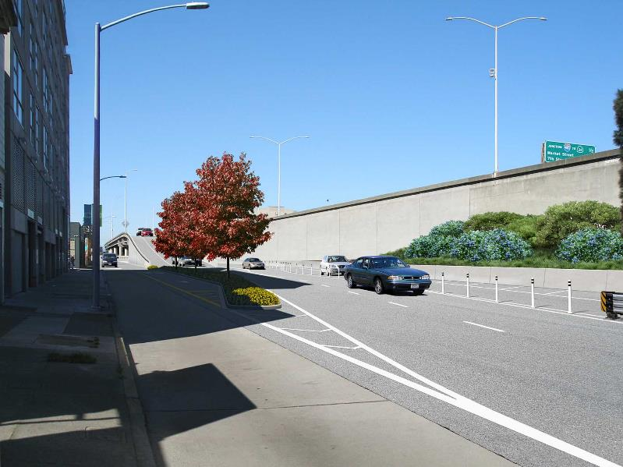
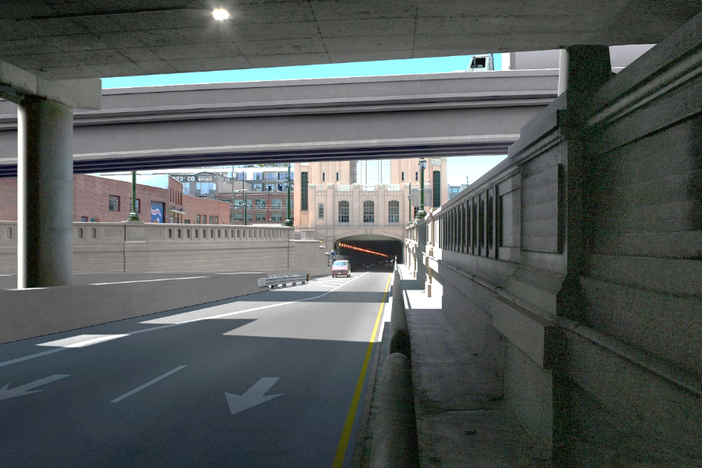
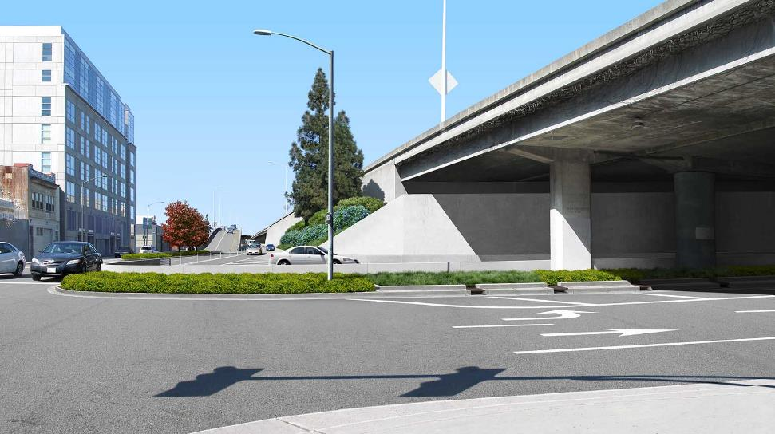
Project Design – Selected Areas
6TH STREET LOOKING WEST TOWARD JACKSON STREET
Removal of the northbound
I-880 off-ramp
Class IV Cycle Track
Removal of the northbound
I-880 Broadway off-ramp
Relocation of westbound I-980 Jackson Street off-ramp to the west
along 5th Street
Extension
of 6th Street
CORNER OF 5TH STREET AND JACKSON STREET LOOKING WEST
Horseshoe connector under I-880
Reconstruction of east wall to construct right-turn from Posey Tube onto northbound I-880 Jackson Street on-ramp

Slide 5
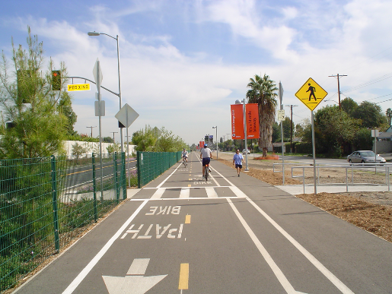
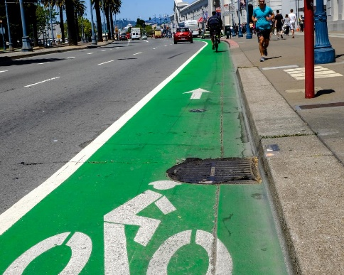
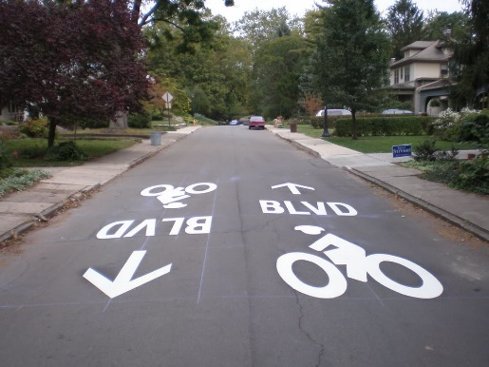
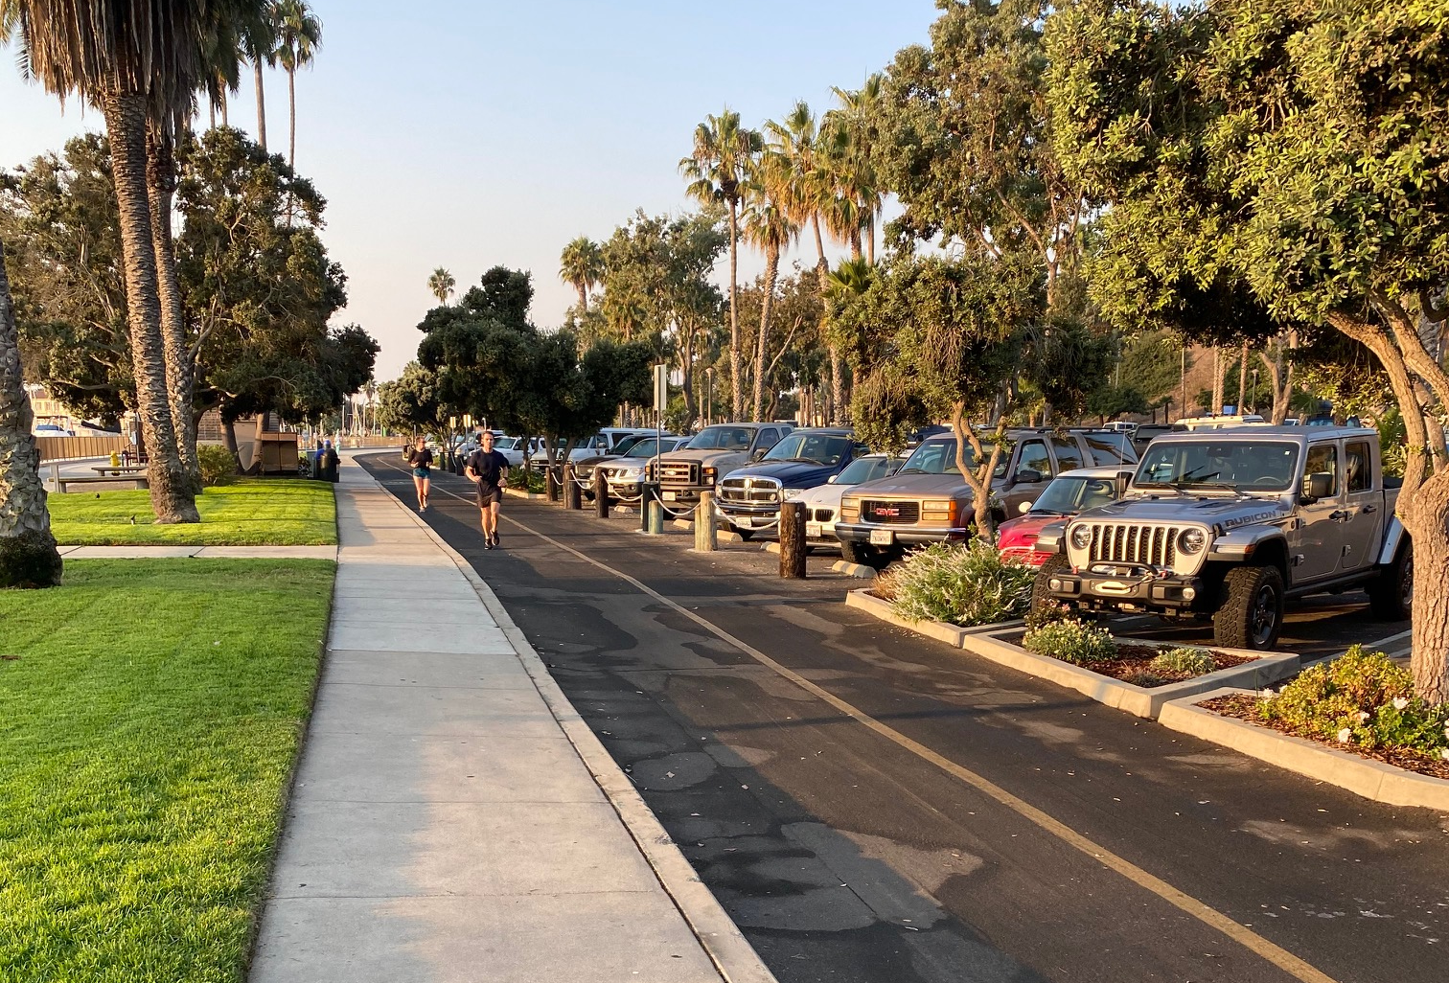
Types of Bicycle Facility
Class I
Shared-Use Path
Class II
Bike Lane (incl. protected lane)
This project will add over 1.9 miles of new bike facilities and
0.7 miles of new sidewalks in Oakland!
0.5 mile
0.4 mile
Class III
Bike Lane (incl. sharrow, Bike Blvd.)
Class IV
Cycle Track
0.2 mile
0.8 mile
Notes:
The project adds over 3 miles of bicycle and pedestrian improvements including all four classes of bicycle facilities.

Slide 6
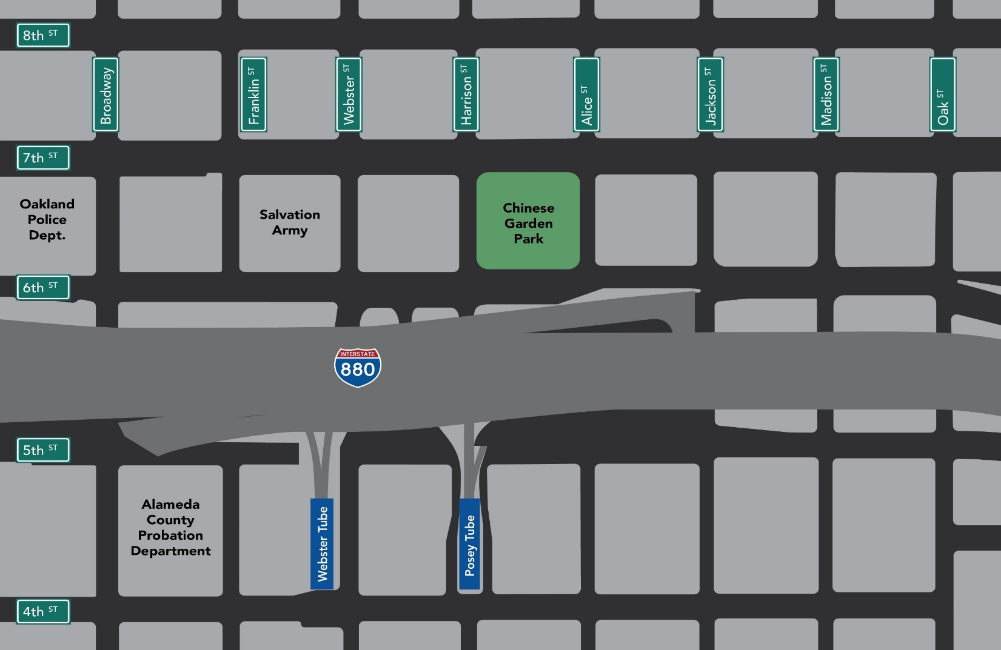


Bike/Ped Safety and Access Improvements in Oakland
Existing sidewalk
Existing bike facility
CHINATOWN
1
Class I – 0.5 miles
Class II – 0.4 miles
Class III – 0.2 miles
Class IV – 0.8 miles
New sidewalk – 0.7 miles
Family Bridges Lake Merritt Child Care
2
5
Chinese Garden Park
5
5
4
3
8 Orchid
5
Chinese Garden Park
5
4
5
1
2
4
3
428
Alice
2
Fourth Street East
1
3
5
JACK LONDON DISTRICT
Notes:
The City of Oakland, Chinatown, Jack London and Bike East Bay have been essential in the formulation of this preliminary Bike/Ped Safety and Access plan in Oakland. In the coming months, the details will continue to be refined.

Slide 7
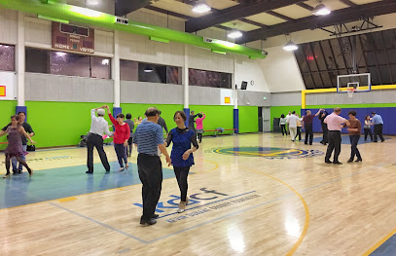
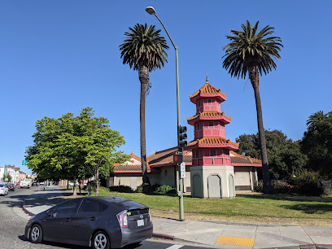
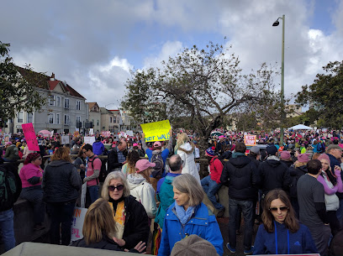
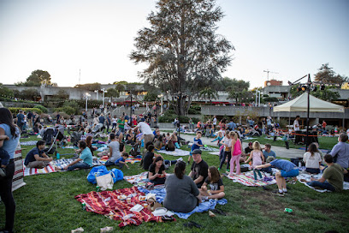
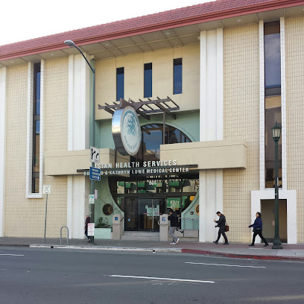
Project Area
CHINATOWN
Chinese Garden Park
5
Family Bridges Lake Merritt Child Care
4
8 Orchid
5
Chinese Garden Park
5
4
5
5
1
6
7
5
428
Alice
2
Fourth Street East
1
3

Slide 8
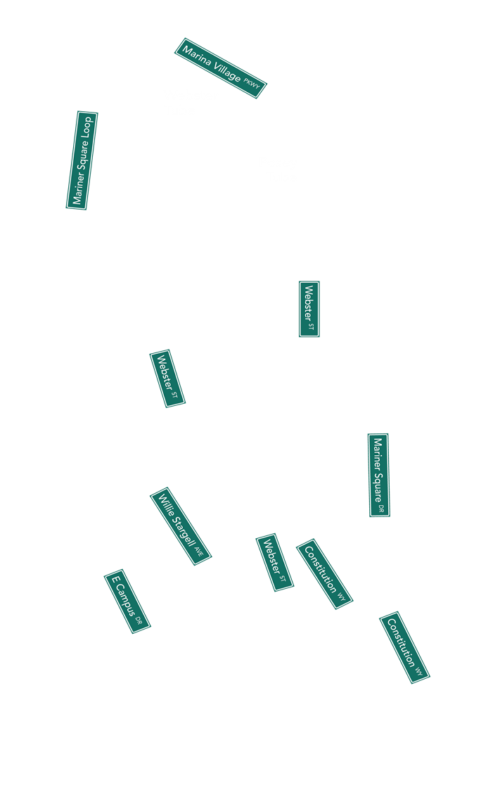
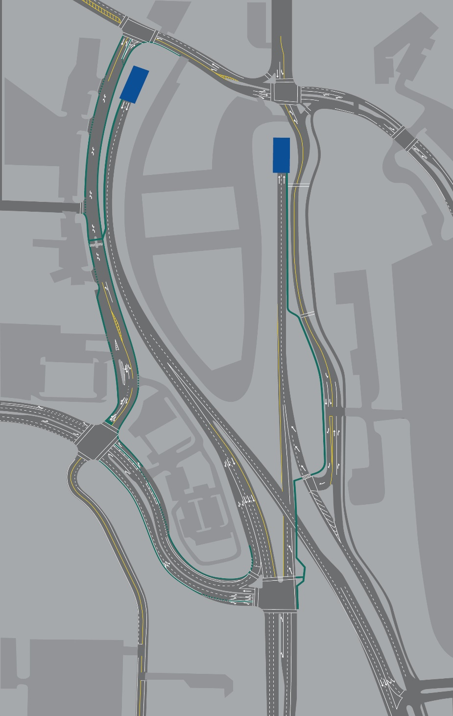

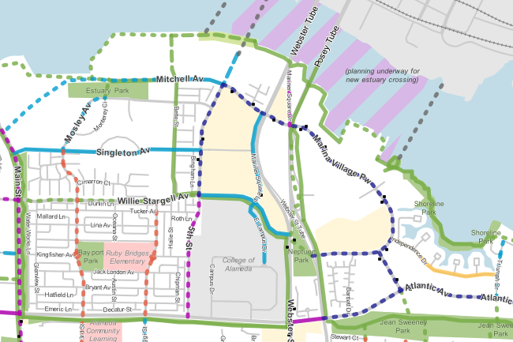

Bike/Ped Safety and Access
Improvements in Alameda
Target
1
5
Widen and open walkway through
Webster Tube and along
Webster Street connecting to
Mariner Square Loop (0.8 miles)
3
1
Alameda
Landing
2
New Class II bike lane on
Mariner Square Loop (0.3 miles)
2
4
3
3
Add crosswalks to connect
ped/bike paths
5
4
New Class I path: Realign and
widen path to 8 feet (0.3 miles)
5
Sidewalk extension on
Mariner Square Loop and Mariner Square Drive (0.3 miles)
3
Notes:
On the Alameda side of the tunnel, 0.5 mile of bicycle and pedestrian improvements provide safety, access and connectivity from the nearby facilities.
We thank Alameda City staff for their input in this preliminary plan.
The yellow highlights the improvements with or without Webster Tube improvements.
On Oakland side, Harrison St connects to Posey Tube.
On Alameda side, Posey Tube connects to Webster St. Webster Tube connects to Webster St Tube.

Slide 9
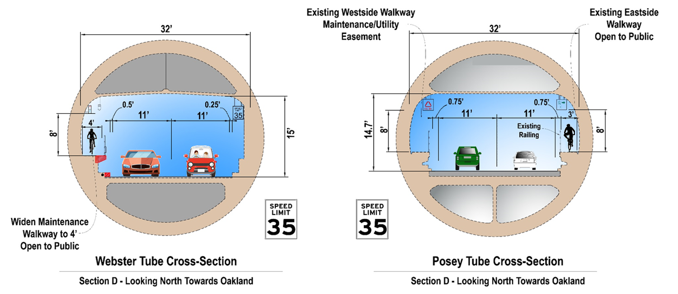
Tube Improvements
3’
Notes:
Improvements to the tunnel include the widening of an existing maintenance path to accommodate bicyclists. This improvement will serve as a two-fold allowing for access during the construction work at the Posey Oakland portal which is expected to be closed for an overall total of 18 months. After construction, the Webster path will remain and the current two way bicycle traffic going through the Posey tube will be separated into one-direction traffic. Bicyclists will go into Oakland via the Posey and into Alameda via the Webster.
Cost of Webster Tube and associated improvements is $7,400,000.
Posey Tube: Existing condition, there is one usable path through Posey Tube shared by bicyclist and pedestrians (3’ min) located on the right side of travel way. There is an existing maintenance path along the left side of travel way that is closed off and not accessible to the public. There is a utility line and call boxes along this path and there access from the Alameda side is not straight forward. The cost of relocating the fire protection line that sits in the way of path is expensive.
Webster Tube: Existing maintenance path is about 2.5’ wide and is currently not accessible to public. There is no existing path on the other side of Webster Tube.

Slide 10
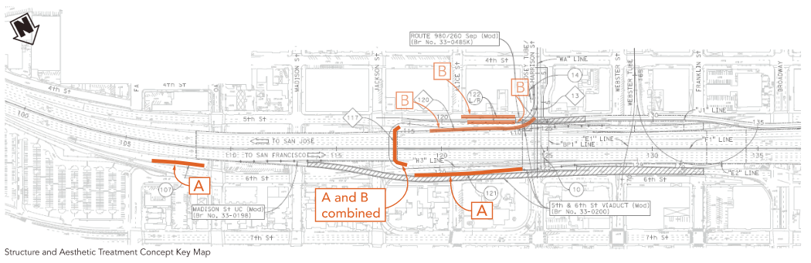
Aesthetics-Key Map
Incorporating Standards for Treatment of Historic Properties including Posey Tube
Adhering to Built Environment Treatment Plan
Compliance with Section 106 of the National Historic Preservation Act

Slide 11
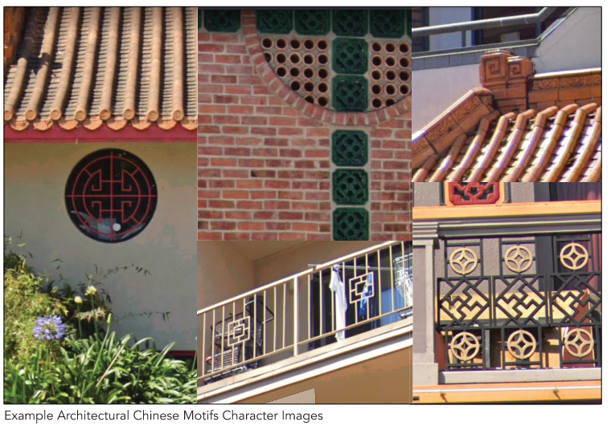
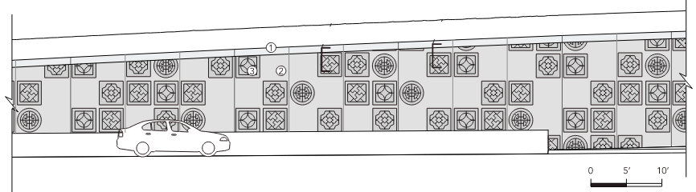
Aesthetics-Concept A (north of I-880)

Slide 12
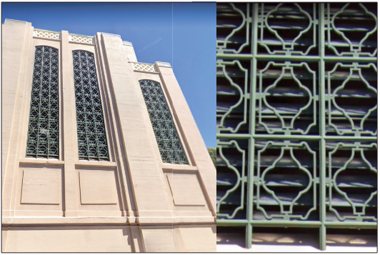
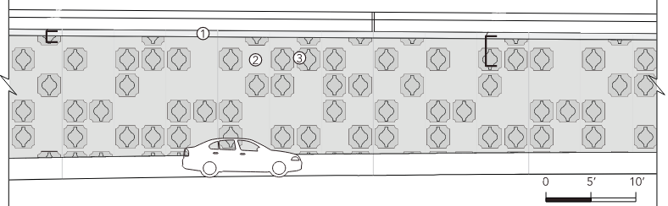
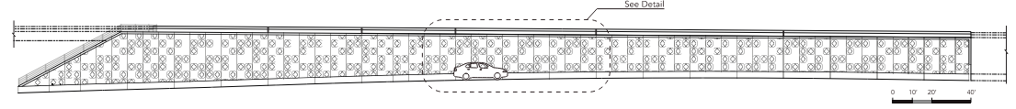
Aesthetics-Concept B (south of I-880)

Slide 13
Construction Schedule
 | 2025 |  |  |  | 2026 |  |  |  | 2027 |  |  |  | 2028
 | Winter | Spring | Summer | Fall | Winter | Spring | Summer | Fall | Winter | Spring | Summer | Fall | Winter | Spring | Summer | Fall
Stage 1
Stage 2

Slide 14
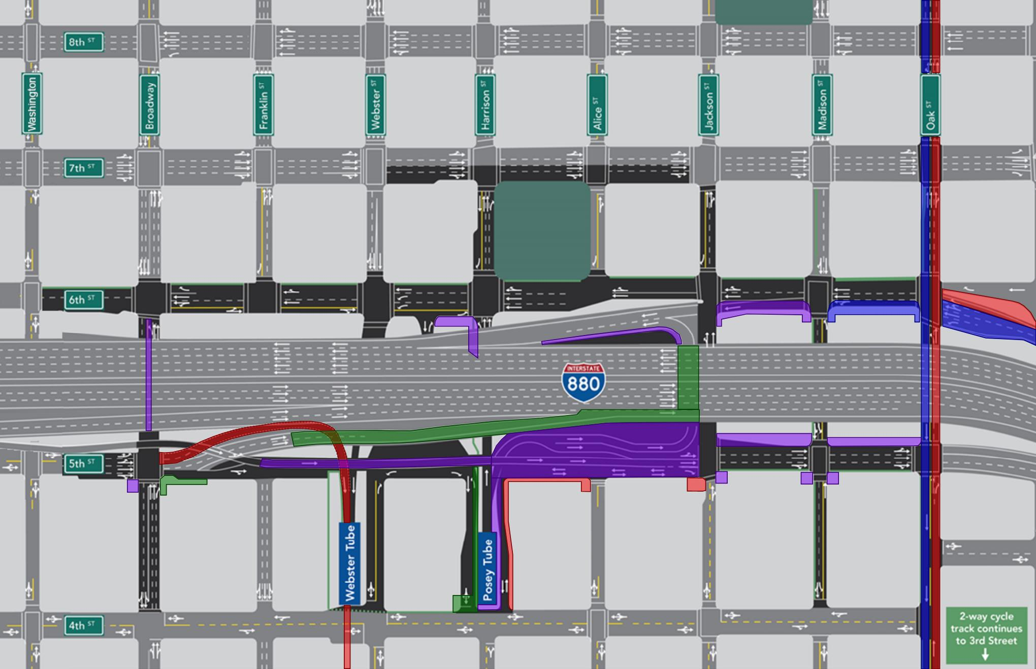
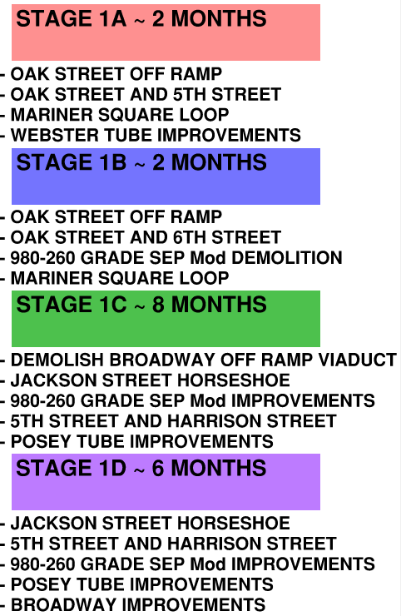
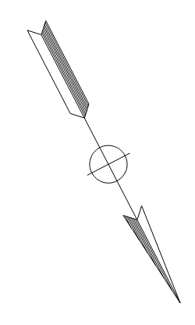
Construction – Stage 1
Duration (1.5 YEARS)

Slide 15
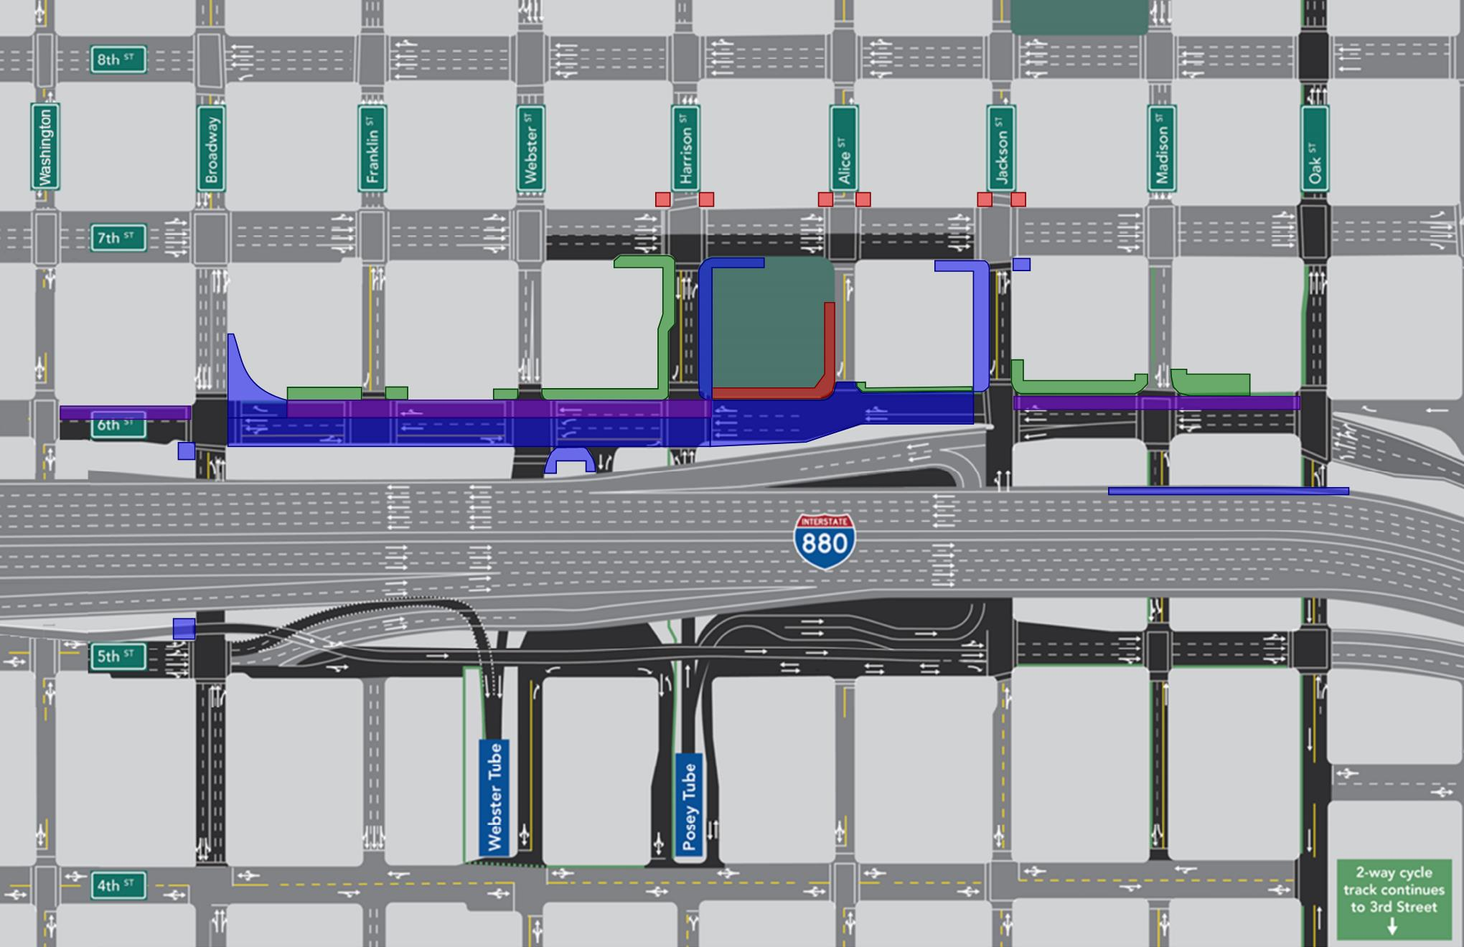
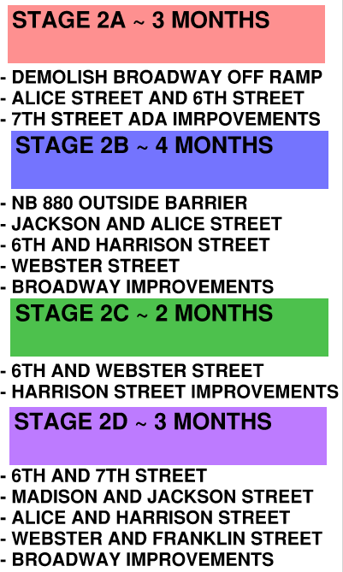
Construction – Stage 2
Duration (1 YEAR)

Slide 16
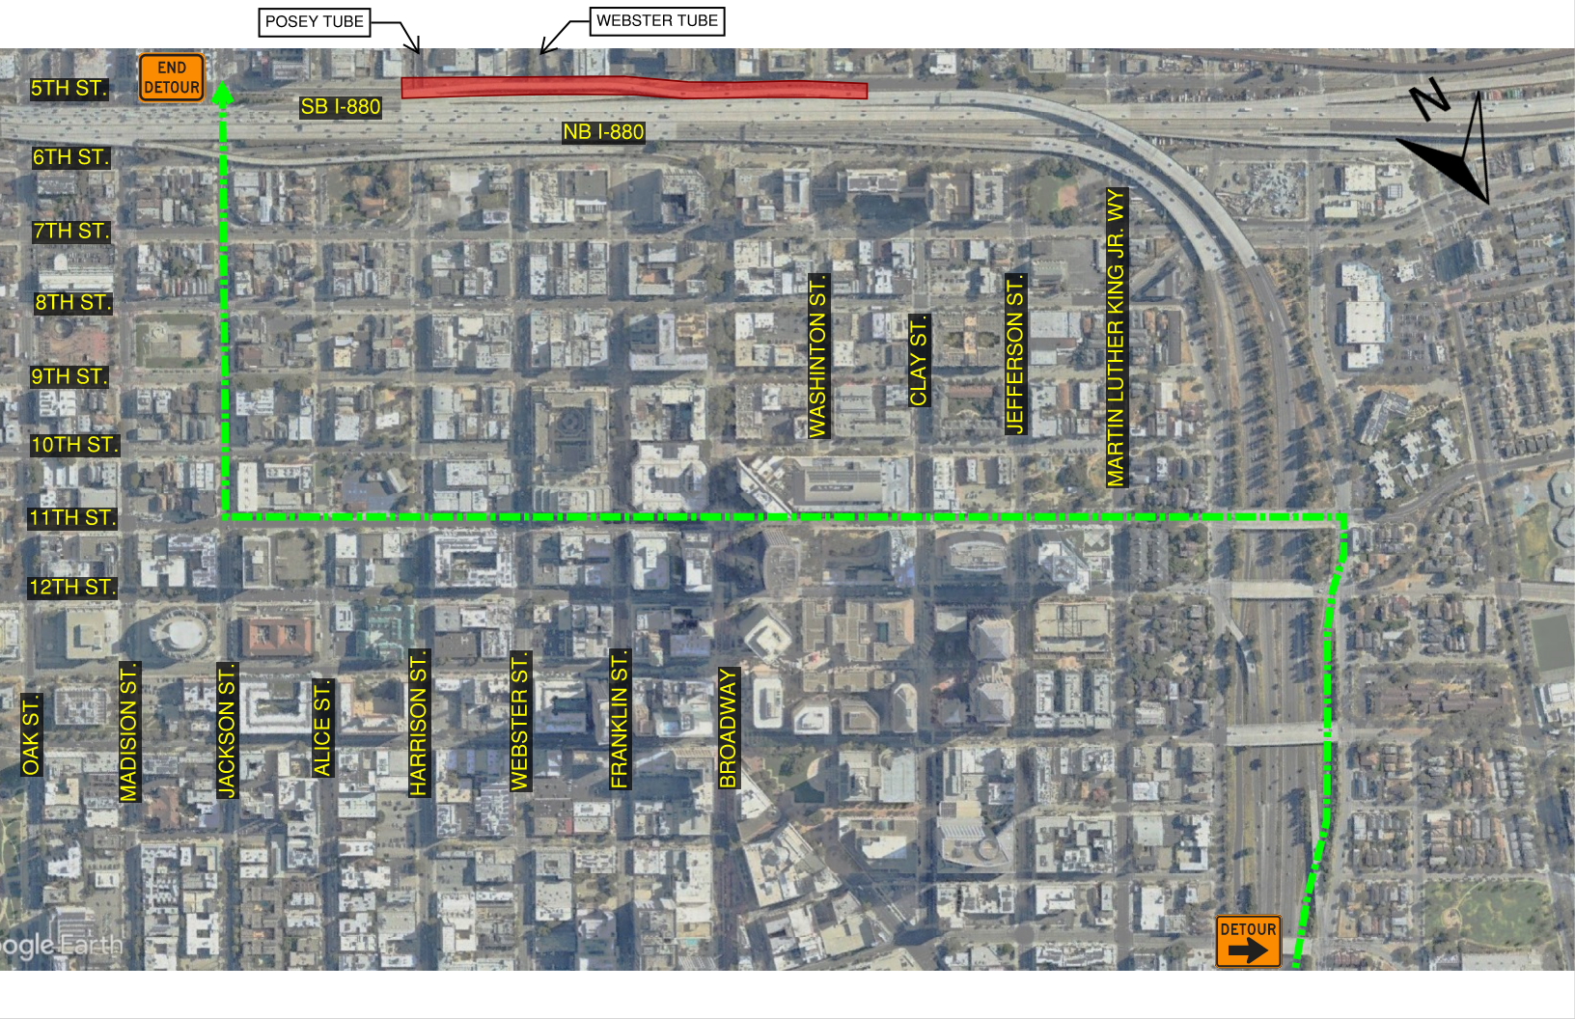
I-980 Jackson Street Off Ramp Detour
Approximately 1 year to Demolish existing structure, realign and construct new structure
Detour will re-route drivers via 11th Street to Jackson Street

Slide 17
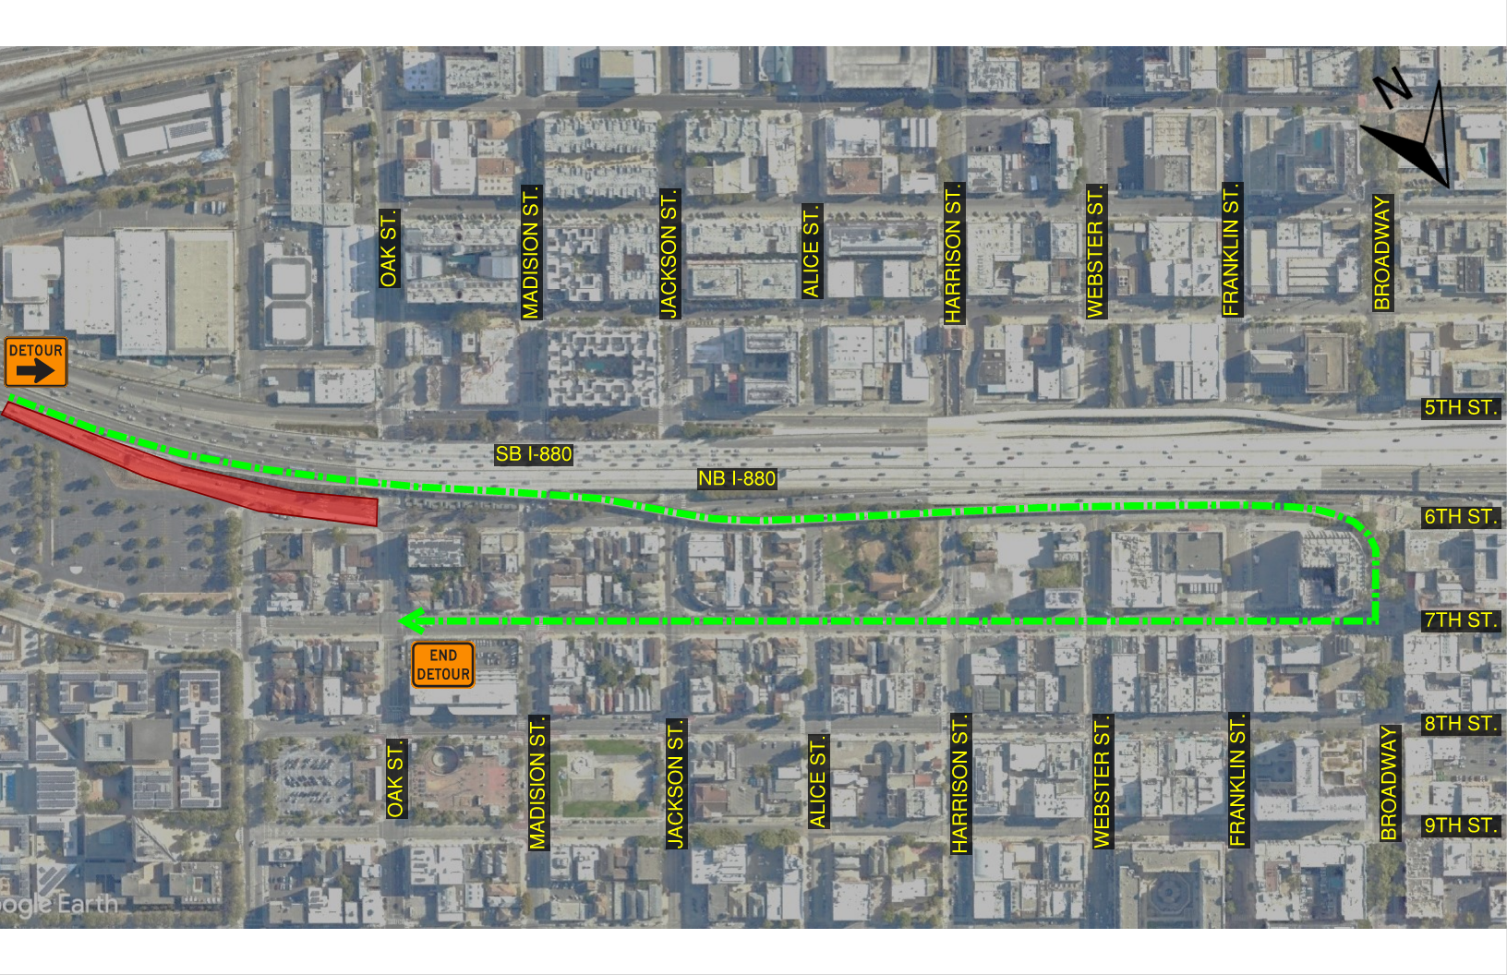
Oak Street Off-Ramp Detour
Nighttime and Weekend closures for ramp improvements
Detour will re-route drivers via Broadway Exit and loop back on 7th Street

Slide 18
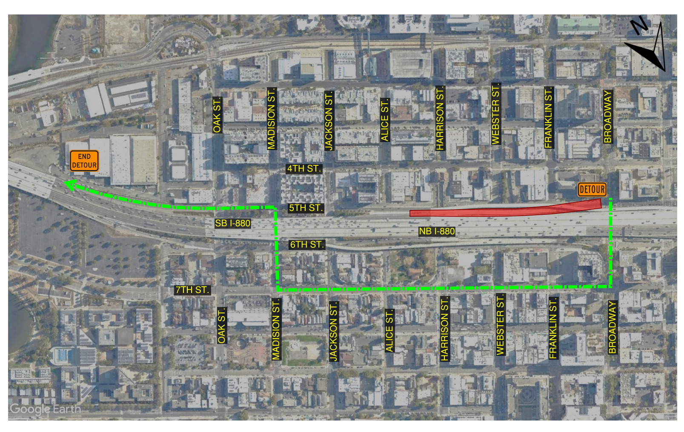
SB I-880 On-Ramp Detour
Approximately 6 months to demolish and reconstruct retaining wall along SB I-880
Detour will re-route drivers via 7th Street to Madison Street to 5th Street

Slide 19
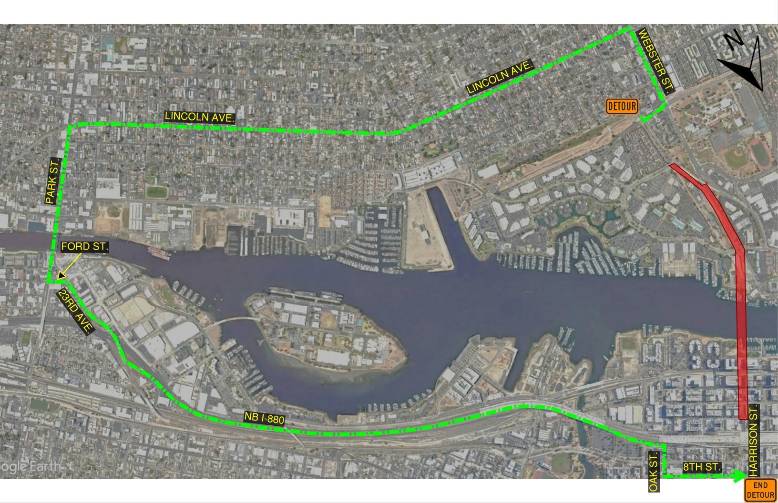
Posey Tube Detour
Nighttime and Weekend closures for structure demolition and traffic control set up
Detour will re-route drivers via Lincoln Ave to Park Street to NB I-880 and exiting on Oak Street

Slide 20
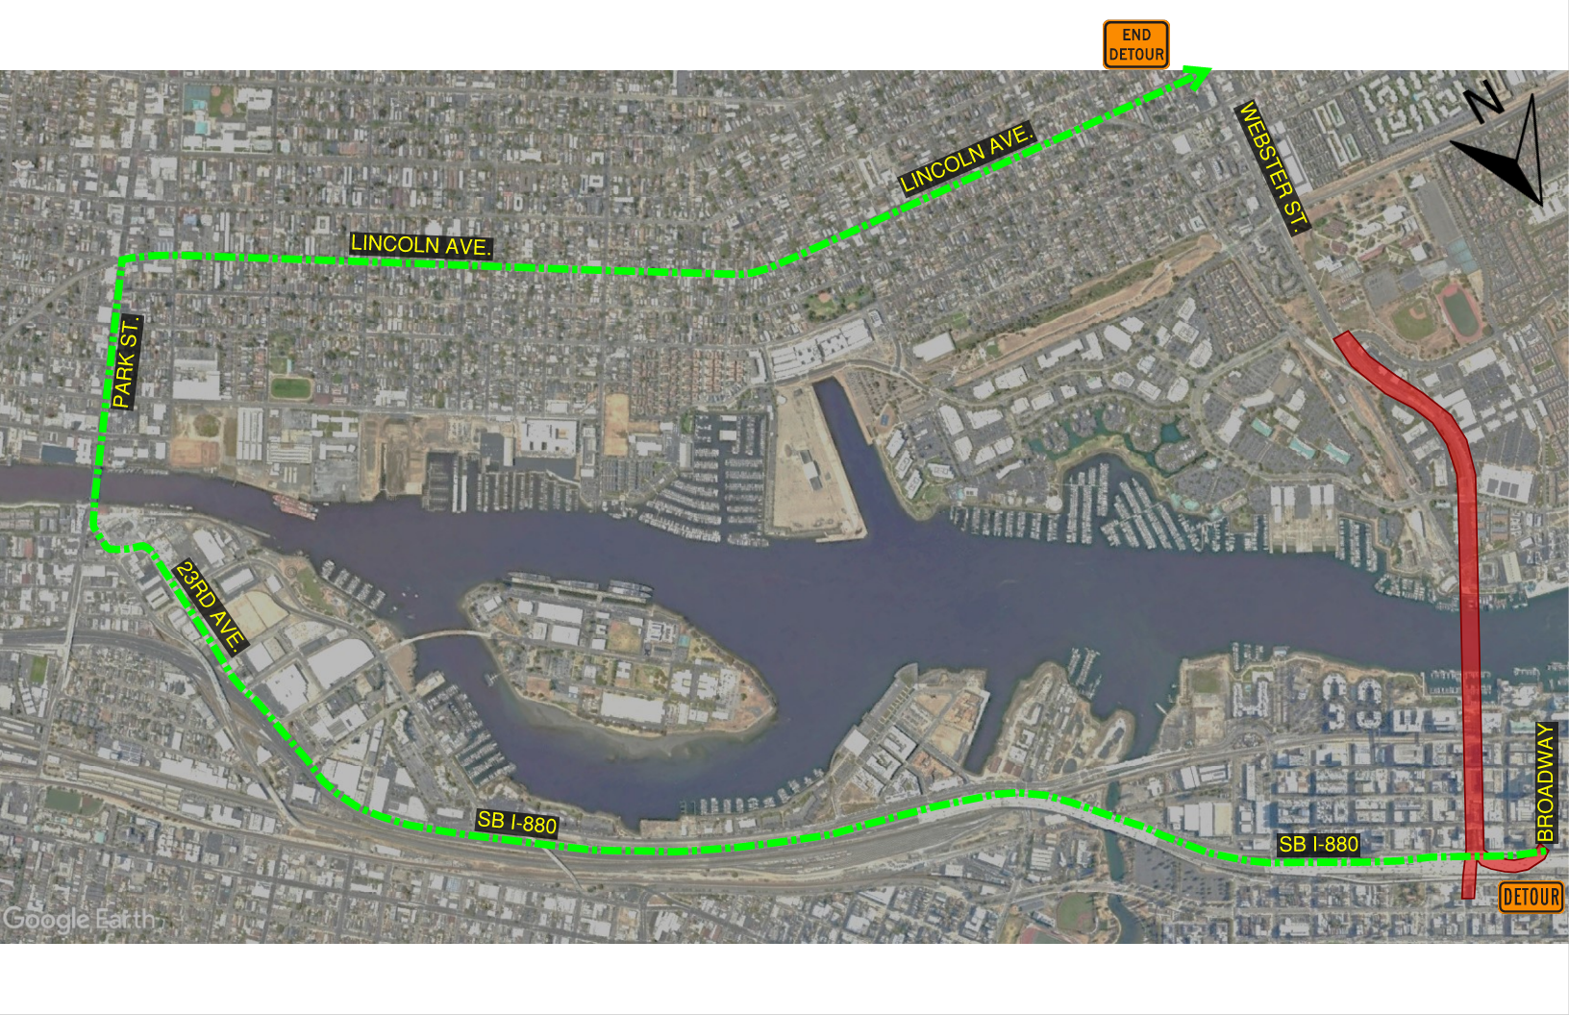
Webster Tube Detour
Nighttime closures for traffic control set up
Detour will re-route drivers via SB I-880 to 23rd Street to Park Street to Lincoln Ave

Slide 21
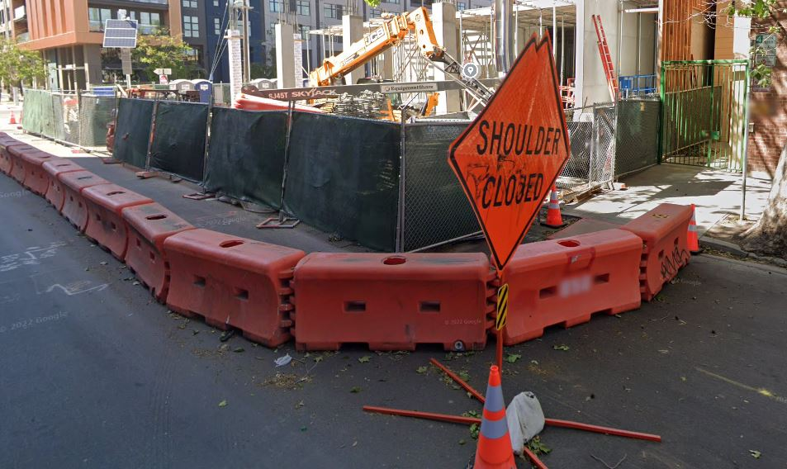
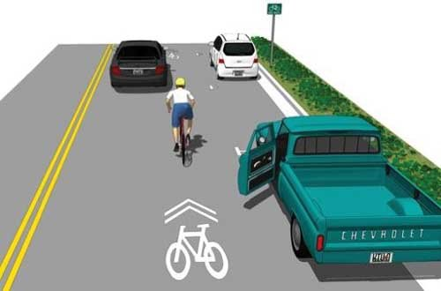
Maintaining Pedestrian and Bike Mobility
Temporary Pedestrian Paths during construction will provide protected walkways around the construction work zones
When existing Class I, II and IV bike facilities are impacted by construction activities Class III bike routes will be provided

Slide 22
Project Schedule
Project Milestone | Schedule By Phase
Scoping | Summer 2009 - Spring 2011
Preliminary Engineering/Environmental | Fall 2017 to Early 2022
Final Design | February 2022 to Fall 2024
Project Advertisement/Bidding Process | Early 2022 to Fall 2024
Construction | Spring 2025 to Summer 2028
*Design has achieved 95% milestone and is progressing to 100%

Slide 23
Questions

Slide 24
Thank you!

