Slide 1
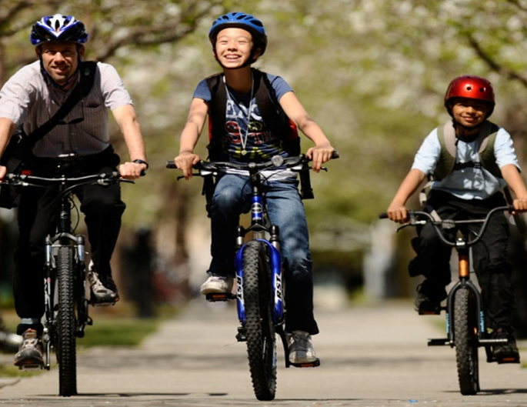
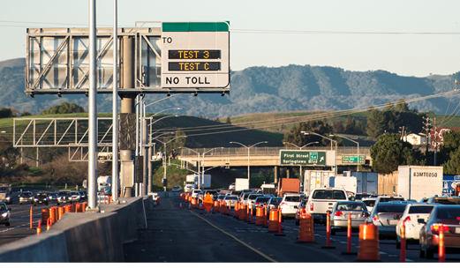
Measure B and Measure BB Direct Local Distributions Program Compliance Report Summary Reporting Fiscal Year 2019-20
ALAMEDA COUNTY TRANSPORTATION COMMISSION
A presentation to the Independent Watchdog Committee
John Nguyen, Principal Transportation Planner
July 2021

Slide 2
DLD Program Overview
$310 M Generated Through Voter-Approved Measures
Over 50% of net revenues generated from the Measure B, Measure BB and Vehicle Registration Fee (VRF) Programs are returned to source as “Direct Local Distributions” (DLDs)
Twenty recipients (cities, transit agencies and the County)
DLD Programs
Bicycle/Pedestrian
Local Streets and Roads (local transportation)
Transit
Special Transportation for Seniors and People with Disabilities (Paratransit)

Slide 3
DLD Revenues
$160.3M Total DLD Revenues
Direct Local Distributions FY2019-20 (dollars in millions)
DLD Programs | Measure B | Measure BB
Local Streets and Roads (Local Transportation for Measure B/BB) | $ 32.3 | $ 29.5
Mass Transit | $ 30.7 | $ 31.7
Special Transportation for Senior and People with Disabilities (Paratransit) | $ 13.1 | $ 13.2
Bicycle and Pedestrian Safety | $ 5.4 | $ 4.4
TOTAL | $ 81.5 | $ 78.8

Slide 4
Compliance Requirements and Review Process
1. Submit Compliance Report and Financial Statement
(Due end of December)
2. Review Process
Alameda CTC and Independent Watchdog Committee
3. Compliance Determination
Commission receives Summary Report
Compliance Purpose & Requirements
Reports revenues & expenses
Documents DLD performance
Documents current pavement condition index
Confirmation of Updated Bike and Pedestrian Master Plans
Documents 15% of MBB LSR funds expended on bike/ped
Documents completion of publicity requirements
Monitors timely use of funds
Reviews revenues & expenses
Confirms compliance with reporting requirements
Monitor Timely Use of Funds
Monitors DLD investments
May request additional information from recipients
Receives Summary Report of Compliance Submittals
Considers exemption requests for Timely Use of Funds.

Slide 5
DLD Expenditure History
$162.3M Total
FY 19-20 Expenditures
$ in millions

Slide 6
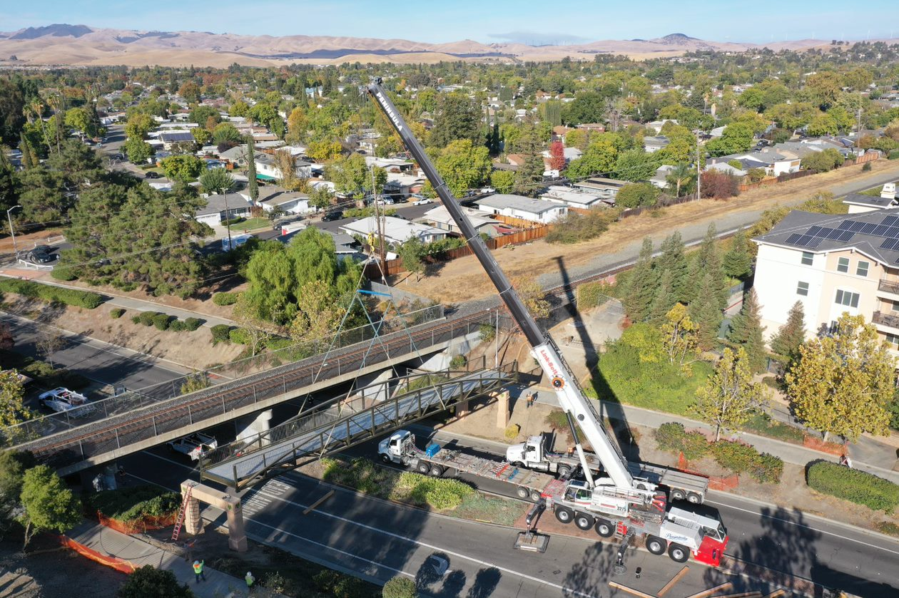
Fiscal Year 19-20 DLD Accomplishments
Measure B/BB Funded Improvements $162.3 million in MB & MBB expenditures
Total Transit Trips | 70 million trips
Total ADA mandated trips | 0.6 million trips
Total Meal Delivery | 177,000 meals
Total Street Rehabilitation | 115 lane miles
Total Bike Lane and Sidewalks | 25 lane miles
Total Bike/Ped Masterplans | 5 cities updating plans
City of Livermore – Iron Horse Trail
^{NOTES}
¹Quanity completed are as reported by the jurisdictions, and represent a rounded value.
²Not all improvement types or activities are shown.
City of Fremont – Walnut Avenue

Slide 7
DLD Performance Measures
DLD Program | Performance Measure | Performance Metric and Standard
Bicycle/Pedestrian | Current Master Plans | Plan(s) no more than 5 years old, based on adoption date.
 | Capital Project and Program Investment | Investment into capital projects and programs is greater than funding program administration
Local Streets and Roads | Capital Project and Program Investment | Investment into capital projects and programs is greater than funding program administration
 | Pavement State of Repair | Maintain a city-wide average Pavement Condition Index of 60 (Fair Condition) or above.
 | Maintain 15% of Measure BB LSR investments on Bicycle/Pedestrian Improvements | Maintain a 15% minimum Measure BB LSR investment to support bicycling and walking.
Mass Transit | On-time Performance | Agencies are expected to maintain or increase on-time performance annually based on operator’s adopted on-time performance target
 | Cost Effectiveness Operating Cost per Passenger | Maintain operating cost per passenger or per revenue vehicle hour/mile
Paratransit | Cost Effectiveness Operating Cost per Passenger | Maintain cost per trip or per passengers Service types such as ADA mandated paratransit, door-to-door service, taxi programs, accessible van service, shuttle service, group trips

Slide 8
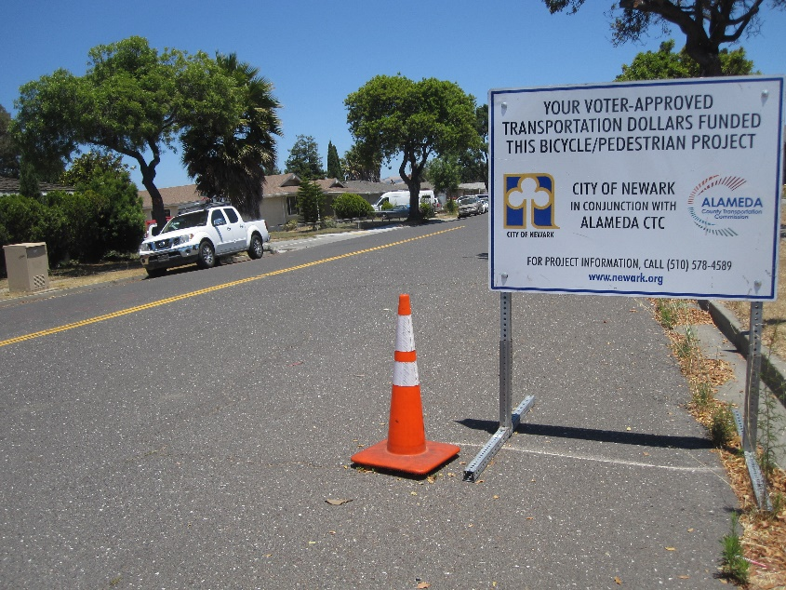
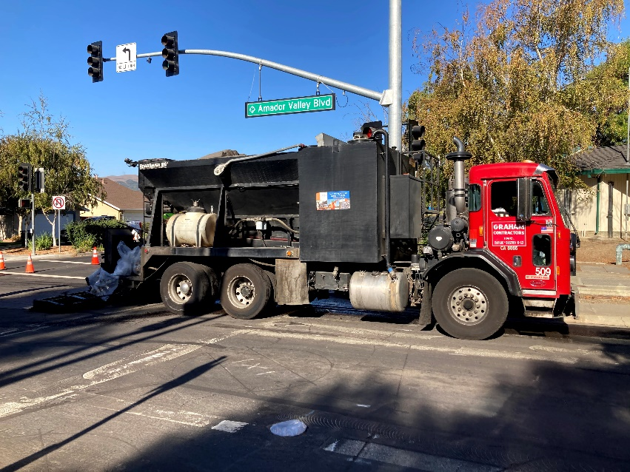
Bicycle/Pedestrian Program Performance Measures
Current Master Plan: Plan(s) no more than five years old, based on adoption date.
Jurisdiction must indicate plans to update outdated plans.
Bicycle and/or Pedestrian Master Plan Status (Adoption Year)
Agency/ Jurisdiction: | Bicycle Plan | Pedestrian Plan | Bicycle / Pedestrian Plan | Anticipated Update Status
ACPWA | N/A | N/A | 2019 | No Update Required.
City of Alameda | 2010 | 2009 | N/A | Approval in 2021/22
City of Albany | N/A | N/A | 2019 | No Update Required.
City of Berkeley | 2017 | 2021 | N/A | No Update Required.
City of Dublin | N/A | N/A | 2014 | Approval in 2021/22
City of Emeryville | 2017 | 2017 | N/A | Approval in 2021/22
City of Fremont | 2018 | 2016 | N/A | No Update Required.
City of Hayward | N/A | N/A | 2020 | No Update Required.
City of Livermore | N/A | N/A | 2018 | No Update Required.
City of Newark | N/A | N/A | 2017 | No Update Required.
City of Oakland | 2019 | 2017 | N/A | No Update Required.
City of Piedmont | N/A | N/A | 2014 | Approval in 2020/21
City of Pleasanton | N/A | N/A | 2018 | No Update Required.
City of San Leandro | 2018 | 2018 | 2018 | No Update Required.
City of Union City | N/A | N/A | 2012 | Approval in 2020/21
City of Newark
City of Dublin
No Update Required affirms no requirement to update this reporting year.

Slide 9
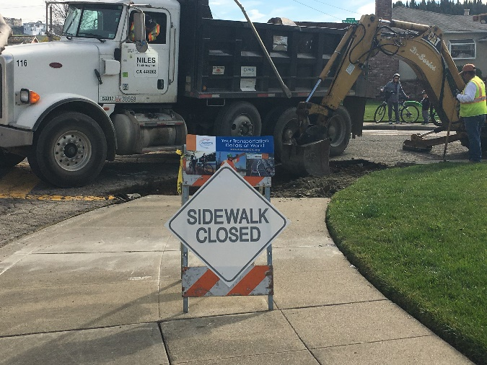
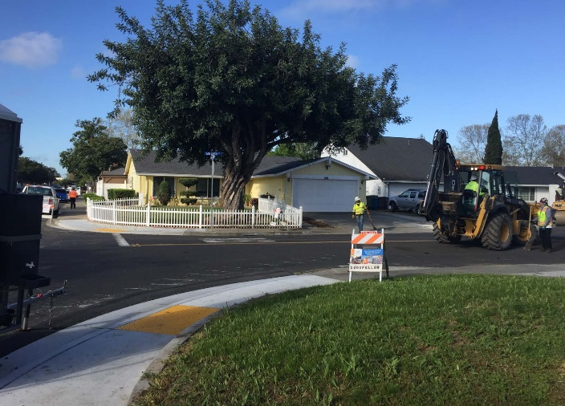
Local Street and Roads Program Performance Measure
City of Emeryville
Pavement Condition Index: Maintain a city-wide average Pavement Condition Index of 60 (Fair Condition) or above.
 | FY 16/17 | FY 17/18 | FY 18/19 | FY 19/20
Alameda County | 71 | 71 | 72 | 71
City of Alameda | 71 | 72 | 71 | 70
City of Albany | 59 | 59 | 57 | 57
City of Berkeley | 59 | 57 | 58 | 57
City of Dublin | 85 | 85 | 85 | 85
City of Emeryville | 79 | 77 | 75 | 74
City of Fremont | 71 | 72 | 73 | 73
City of Hayward | 70 | 70 | 70 | 70
City of Livermore | 76 | 78 | 78 | 79
City of Newark | 76 | 76 | 75 | 75
City of Oakland | 56 | 54 | 54 | 53
City of Piedmont | 64 | 61 | 62 | 64
City of Pleasanton | 78 | 79 | 78 | 79
City of San Leandro | 56 | 57 | 56 | 57
City of Union City | 82 | 81 | 79 | 78
City of San Leandro
Source: MTC 2019 Pavement Condition of Bay Area Jurisdictions https://mtc.ca.gov/sites/default/files/PCI_table_2019_data.pdf
PCI scores are based on a three-year rolling average.
Union City

Slide 10
Local Street and Road Program Performance Measure
15% Measure BB LSR Requirement: Requires 15% of Measure BB Local Streets and Roads (LSR) DLD funds to be spent on improvements benefiting bicyclists and pedestrians.
Jurisdiction: | Total LSR Expenditures to Date | Total LSR Expenditures on Bike/Ped to Date | Percentage of LSR Expenditures on Bike/Ped over Total LSR Expend | 15% minimum LSR achieved?
ACPWA | $12,402,139 | $11,468,926 | 92% | Yes
City of Alameda | $8,162,250 | $5,535,892 | 68% | Yes
City of Albany | $416,555 | $219,375 | 53% | Yes
City of Berkeley | $8,854,487 | $2,553,032 | 29% | Yes
City of Dublin | $1,984,641 | $698,054 | 35% | Yes
City of Emeryville | $1,065,300 | $254,442 | 24% | Yes
City of Fremont | $11,542,333 | $4,803,343 | 42% | Yes
City of Hayward | $7,456,034 | $1,510,746 | 20% | Yes
City of Livermore | $3,297,739 | $948,650 | 29% | Yes
City of Newark | $1,768,169 | $713,356 | 40% | Yes
City of Oakland | $53,418,708 | $9,029,774 | 17% | Yes
City of Piedmont | $2,109,638 | $407,378 | 19% | Yes
City of Pleasanton | $3,179,657 | $639,731 | 20% | Yes
City of San Leandro | $6,005,063 | $1,430,679 | 24% | Yes
City of Union City | $2,373,882 | $543,458 | 23% | Yes
Total | $124,036,597 | $40,756,837 | 33% | Yes

Slide 11
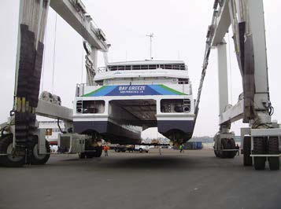
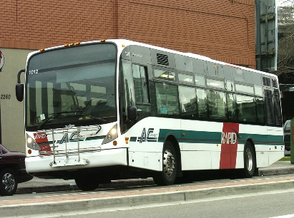
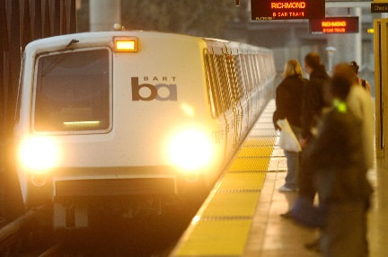
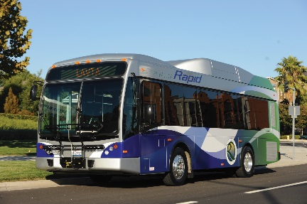
Transit Program Performance Measures
On-time Performance: Maintain or increase on-time performance annually based on operator’s adopted on-time performance target
 |  | On-Time Performance Actual
Jurisdiction: | On-Time Goal | FY 16/17 | FY 17/18 | FY 18/19 | FY 19/20 | Under/Over Goal
AC Transit | 72% | 69% | 70% | 70% | 73% | 1%
ACE | 95% | 94% | 89% | 89% | 76% | -19%
BART | 91% | 89% | 92% | 92% | 89% | -2%
LAVTA | 85% | 81% | 85% | 85% | 88% | 3%
Union City Transit | 90% | 94% | 92% | 92% | 92% | 2%
WETA | 95% | 89% | 96% | 95% | 97% | 2%
Cost Effectiveness: Maintain operating cost per passenger
 | FY 17/18 |  | FY 18/19 |  | FY 19/20
Jurisdiction: | Total MB/BB Cost | Total Cost | Total MB/BB Cost | Total Cost | Total MB/BB Cost | Total Cost
AC Transit | $1.13 | $8.83 | $1.19 | $9.43 | $1.40 | $12.11
ACE | $2.91 | $2.91 | $2.47 | $2.47 | $4.23 | $4.23
BART | $0.02 | $0.02 | $0.02 | $0.02 | $0.03 | $0.03
LAVTA | $1.05 | $8.28 | $1.12 | $9.19 | $1.23 | $10.91
Union City Transit | $3.04 | $13.61 | $3.50 | $15.32 | $4.56 | $18.24
Notes:
Costs per trip includes the total Measure B/BB costs divided by number of passenger trips reported by the operator.
Cost per trip varies from agency to agency based on local needs, services provided, program administration, and DLD implementation.
WETA reported no expenditures on service operations;

Slide 12
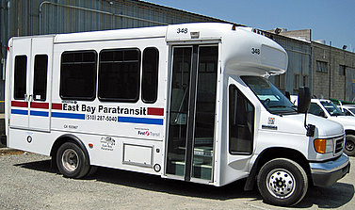
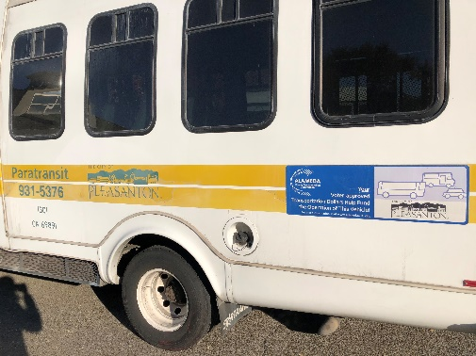
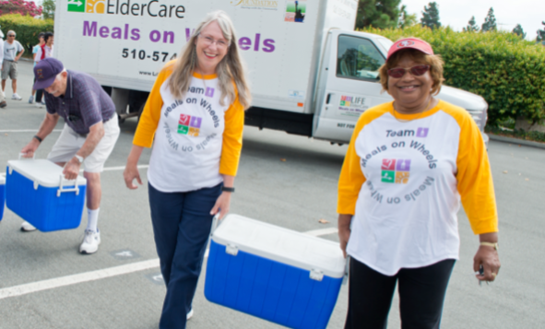
Paratransit Program Performance Measures
Cost Effectiveness of Services: Maintain cost per trip or per passengers
Service types such as ADA mandated paratransit, city-based door-to-door service, taxi programs, accessible van service, shuttle service, group trips
BART/AC Transit
ADA Mandated Services
 | FY 17/18 |  |  | FY 18/19 |  |  | FY 19/20
Agency | No. of one- way Trips | MB/BB Cost | Total Cost | No. of one- way Trips | MB/BB Cost | Total Cost | No. of one- way Trips | MB/BB Cost | Total Cost
AC Transit | 531,840 | $23.18 | $48.65 | 511,357 | $26.07 | $57.86 | 383,937 | $33.23 | $70.32
BART | 238,942 | $18.13 | $18.13 | 229,740 | $20.45 | $58.07 | 172,493 | $25.30 | $70.99
LAVTA | 50,967 | $9.77 | $9.77 | 46,108 | $12.19 | $39.44 | 34,687 | $15.19 | $46.56
Union City | 18,028 | $28.57 | $28.57 | 15,382 | $38.23 | $62.13 | 14,638 | $38.11 | $65.77
Pleasanton
Notes:
ADA Mandated Services for AC Transit/BART are provided through the East Bay Paratransit Consortium (EBPC).
Meals on Wheels Program
Meal Delivery | FY 17/18 |  |  | FY 18/19 |  |  | FY 19/20
Agency | Number of Meals | MB/BB Cost | Total Cost | Number of Meals | MB/BB Cost | Total Cost | Number of Meals | MB/BB Cost | Total Cost
Alameda |  |  |  |  |  |  | 3,846 | $6.50 | $6.50
Emeryville | 4,142 | $0.08 | $0.08 | 4,963 | $0.04 | $0.04 | 11,601 | $0.01 | $0.01
Fremont | 62,190 | $1.20 | $1.20 | 62,115 | $1.21 | $1.21 | 65,609 | $1.15 | $1.15
Hayward | 44,944 | $1.53 | $1.53 | 25,000 | $3.25 | $3.25 | 78,904 | $0.95 | $0.95
Newark | 14,361 | $0.49 | $0.49 | 14,305 | $0.49 | $0.49 | 17,811 | $0.39 | $0.39
Fremont

Slide 13
DLD Fund Balance and Utilization
Jurisdiction: | Total MB/BB Balance | Total Encumbrance | Total Remaining (Bal. - Encumbered)
AC Transit | $10,816,258 | $10,816,258 | $0
BART | $0 | $0 | $0
LAVTA | $0 | $0 | $0
WETA | $2,273,797 | $203,052 | $2,070,745
ACE | $1,249,433 | $1,249,433 | $0
Alameda County | $1,223,468 | $355,124 | $868,344
City of Alameda | $3,690,669 | $1,649,359 | $2,041,310
City of Albany | $4,050,606 | $743,000 | $3,307,606
City of Berkeley | $12,232,968 | $3,506,180 | $8,726,789
City of Dublin | $1,185,212 | $1,185,212 | $0
City of Emeryville | $1,469,404 | $839,746 | $629,658
City of Fremont | $3,852,470 | $1,026,983 | $2,825,487
City of Hayward | $15,899,926 | $5,323,368 | $10,576,557
City of Livermore | $5,471,999 | $4,095,000 | $1,376,999
City of Newark | $2,028,570 | $519,950 | $1,508,620
City of Oakland | $18,725,900 | $3,091,182 | $15,634,718
City of Piedmont | $2,366 | $2,366 | $0
City of Pleasanton | $3,537,037 | $3,150,123 | $386,914
City of San Leandro | $4,510,008 | $2,177,297 | $2,332,711
City of Union City | $4,157,243 | $2,382,480 | $1,774,763
Total | $96,377,334 | $42,316,113 | $54,061,221
Fund Balance represents accounting balance as of June 30, 2020.
Recipients actively expending balances with encumbrances towards ongoing projects and programs.
Fund balances are also strategically planned and committed as a leveraging source for competitive opportunities.

Slide 14
Program Compliance Determination Reporting Fiscal Year 2019/20
All DLD Recipients In-Compliance
DLD recipients submitted compliance reports and audited financial statements that complied with:
2000 Measure B Transportation Expenditure Plan
2014 Measure BB Transportation Expenditure Plan
Alameda CTC Policies and Program Compliance requirements
Met performance targets or provided corrective plans
Program Compliance Reports Available: https://www.alamedactc.org/funding/reporting-and-grant-forms/.

