Slide 1
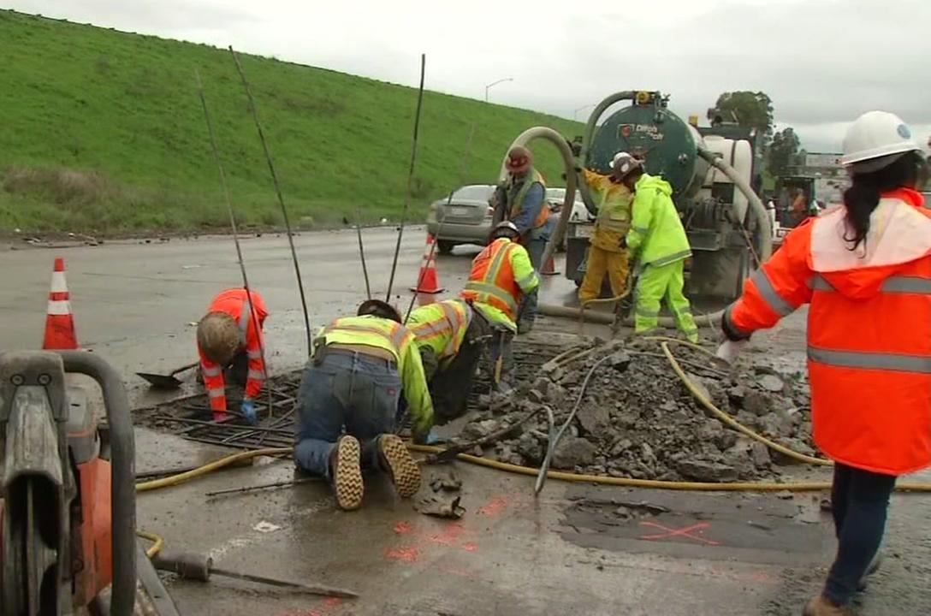
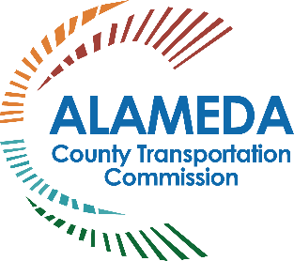
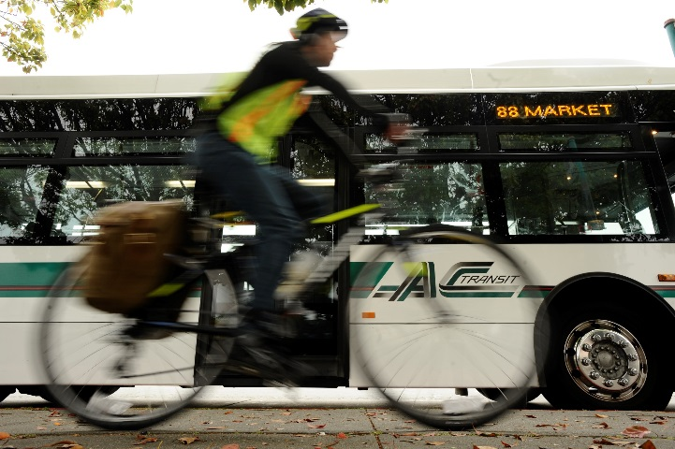
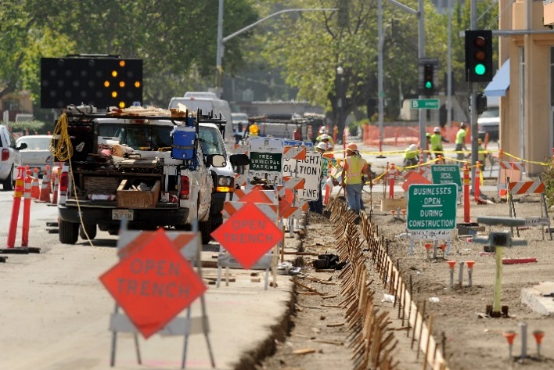
ALAMEDA COUNTY TRANSPORTATION COMMISSION
Proposition 6 Puts Senate Bill 1
Infrastructure Investments At Risk
  For presentations throughout Alameda County

Slide 2
Local Dollars Create Powerful Returns
Alameda County voters have supported three transportation
sales tax measures to deliver major projects and programs
Local tax dollars attract significant state and federal funds
  1986 Measure B: One-to-one leveraging
  2000 Measure B: Three-to-one leveraging
    Delivered $3 billion program with $750 million of local sales tax money
  2014 Measure BB: Project delivery WILL depend on Senate Bill 1 (SB 1) and
  Regional Measure 3 (RM 3)
    Almost 10-fold leveraging of funds on recent projects: Port modernization projects serving Northern California – $19 million local money attracts over
    $183 million in SB 1 funds
Notes:
Voters in Alameda County have supported three separate transportation sales tax measures because they have seen results and they know that local money attracts other funding to deliver projects faster.
In 1986, voters approved Measure B with 81.5% of the vote, which was able to
double the amount of funding for project delivery for BART extensions to Castro Valley and Dublin/Pleasanton, highway improvements on I-880, I-580, I-680, SR-24, SR-84 and
SR-238, and improved roadway access to the Oakland Airport.
In 2000, voters approved Measure B, an extension of the first measure for another
20 years, which was able to triple the amount of funding (for every local $1, we secured $3 additional dollars in regional, state and federal funds) for BART extensions to the Oakland Airport and to South Fremont (Warm Springs – a critical link in getting BART to San Jose), highway improvements on I-80, I-238, I-580, I-680, I-880 – including new interchanges, advanced technology and new facilities that increase safety and highway efficiency; roadway safety improvements; transit operations; senior and disabled services; and bicycle and pedestrian trails, sidewalks and safety enhancements.
The major infrastructure projects in the 2000 measure were delivered in half the time because we attracted external funds that matched local dollars.
In 2014, voters approved Measure BB to add funding and extend the 2000 sales tax measure to continue delivering transit, highway, road, rails, trails, pedestrian safety enhancements and transit services to seniors, youth and disabled. In just four years, Alameda CTC has been able to continue attracting funds on projects, in some cases doubling our local dollar investments, such as on the $220M SR-84/I-680 Interchange project (Note: SR 84/680 Fact Sheet: $108M local sales tax dollars, attracted $112 in other funds= over 2 times the local sales tax investment) and attracting almost 10 times the amount of local funding on goods movement projects at the Port of Oakland in Alameda County which serves the entire Northern California (Note: 7SGSE Fact Sheet: $19M local, attracted $183.3 in other funds = almost 10 times the local investment)
NEXT SLIDE

Slide 3
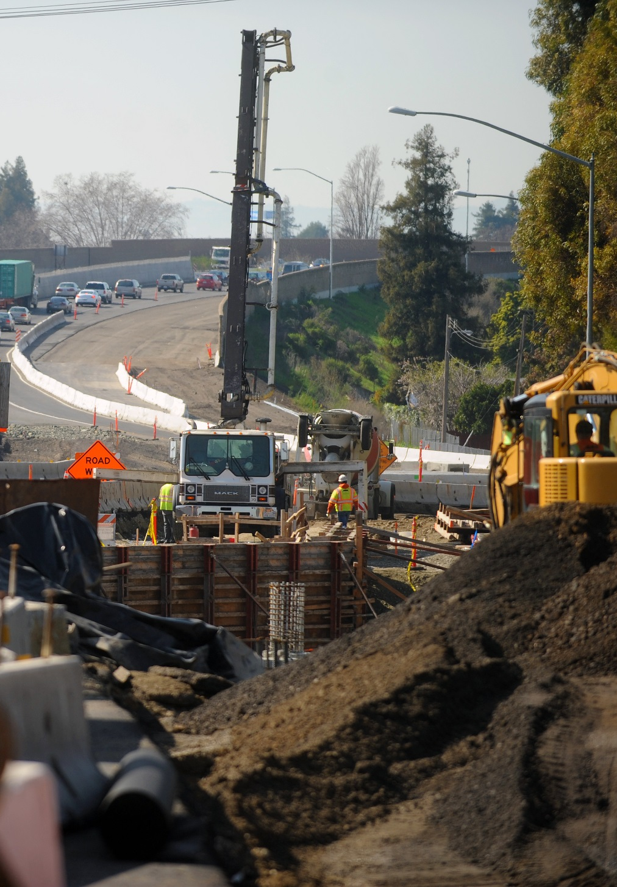
Local Sales Tax Dollars
Deliver Local Improvements
Local sales tax investments include
improvements and maintenance for:
  Roadway reconstruction
  Ongoing pavement rehabilitation
  Construction of bicycle/pedestrian paths
  Senior and disabled transportation
  Transit operations
Notes:
Sales tax funding facilitates local delivery.
Local sales tax investments include improvements and maintenance for:
Roadway reconstruction
Ongoing pavement rehabilitation
Construction of bicycle/pedestrian paths
Senior and disabled transportation
Transit operations
NEXT SLIDE

Slide 4
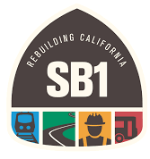
Senate Bill 1 – Approved New Transportation Funding
Invests $5.4 billion annually to repair California’s transportation network
Reliable funding to deliver major projects
Stable funding for potholes repair and for mass transit capital improvements
Funds are constitutionally protected under Proposition 69
SB 1 is a gas tax, vehicle fees fund to support transportation maintenance and operations
Notes:
Senate Bill 1 is a landmark funding program that:
Invests ~$5.4 billion annually in state and local roads, public transit and active transportation programs
Addresses a backlog of repairs, upgrades and safety needs on local streets and roads
Accelerates delivery of projects
And importantly, its funds are constitutionally protected by Assembly Constitutional Amendment No. 5 (ACA 5) that safeguards new dollars for transportation use only
NEXT SLIDE

Slide 5
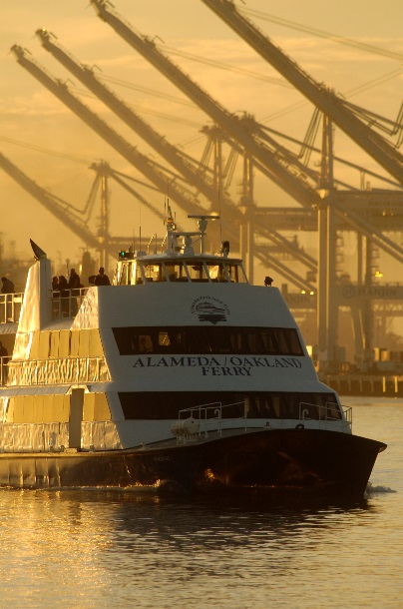
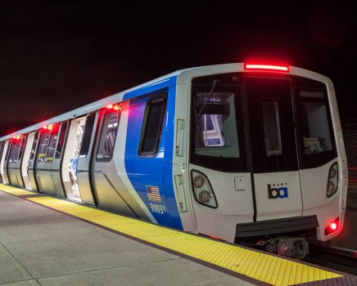
SB 1 – The State Has Finally Stepped Up!
Funds backlog highway, bridge and pedestrian safety, and transit systems
  State gas tax had not been increased for a
  quarter century
Enables cities and counties to address significant maintenance, rehabilitation and safety needs on the local street and road system
Notes:
SB 1 funding closes the funding gap for our highway projects on every interstate in Alameda County.
Transit (BART cars, AC Transit buses and services, LAVTA and Union City Transit services, and ferry expansion) and intercity rail
Goods movement for rail safety and port efficiency projects
Community investments in bikeways, multimodal arterials for pedestrian safety, express transit services, and
Local roadway improvements
NEXT SLIDE

Slide 6
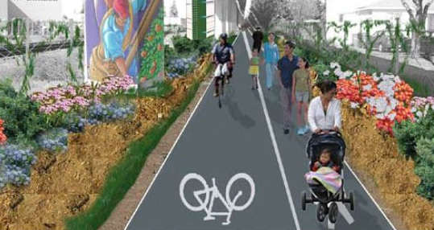
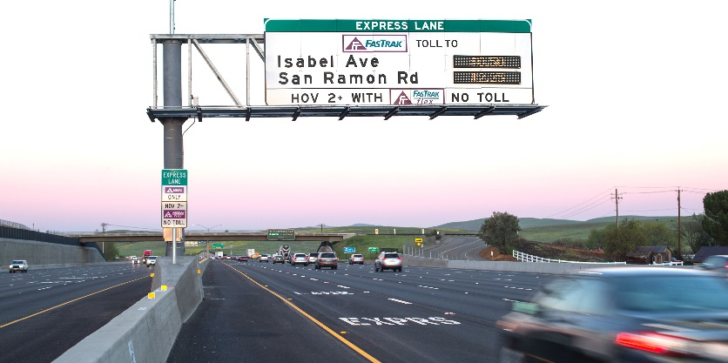
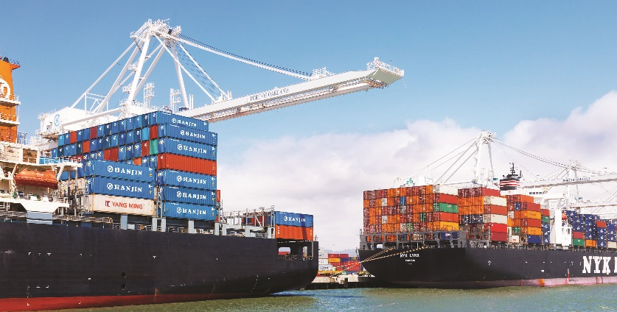
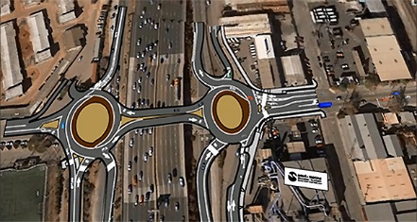
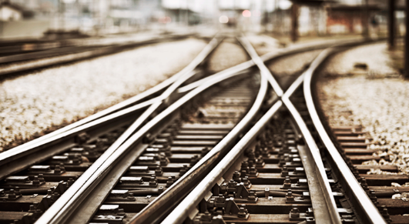
Over $350 Million in New Funding From SB 1
BIKEWAYS
EXPRESS LANES
GOODS MOVEMENT
INTERCHANGES AND HIGHWAYS
INTERREGIONAL RAIL SERVCIES
MULTIMODAL ARTERIAL CORRIDORS
Notes:
Alameda County has already seen over $350 M in new funding from SB 1 for roads, transit, goods movement and intercity rail.
On May 16th of this year, Alameda CTC was awarded $187.4 M for several projects proposed by Alameda CTC and partners that are in the Alameda County Rail Strategy, a project that I will detail a bit later in this presentation.
Additionally,
Quiet Zone Safety Engineering Measures
$4.2 M: sponsored by the City of Emeryville
Local Partnership Program
$7.9 M: 7th Street Grade Separation Project (formulaic funding in March 2018)
Transit and Intercity Rail Capital Program
$80.0 M: Capital Corridor Joint Powers Authority for the Northern California Corridor Enhancement Program to increase ridership by moving trains 10-15 minutes faster in congested corridor through Oakland Coliseum to San Jose
_____________________________________
Bikeways - such as the East Bay Greenway connecting Oakland to Hayward will give bicyclists safe access to jobs, education, transit and other important destinations.
Express lanes - along I-580 and I-680 increase highway efficiency for commuters, transit and freight, using existing capacity to reduce congestion and improve air quality.
Goods movement - improvements in Alameda County can support jobs and local communities, supporting the Bay Area economy.
Interchanges and highways - provide critical connections throughout the county. I-80/Gilman Street and the I-80/Ashby Avenue interchange projects will improve navigation and traffic flow.
Interregional rail services - support freight and passenger services in Alameda County and
Northern California.
Multimodal arterial corridors - planning underway for transit priority and bike/ped improvements will increase safety for all travelers, reduce travel conflicts and accommodate future growth.
NEXT SLIDE

Slide 7
What Is Proposition 6?
Repeals SB 1 funding for transportation infrastructure
Proposition 6 eliminates:
  Over $40 million per year in road maintenance funds from city and county budgets
  All SB 1 funding designated for state highways
  More than $30 million per year in transit funds in Alameda County
  Potential future transportation tax revenues
Requires legislation to submit any measure enacting specified taxes or fees on gas or diesel fuel, or on the privilege to operate a vehicle on public highways, to the electorate for approval
Jeopardizes improvements to highways, rail, goods movement, roads, bridges, trails and pedestrian safety

Slide 8
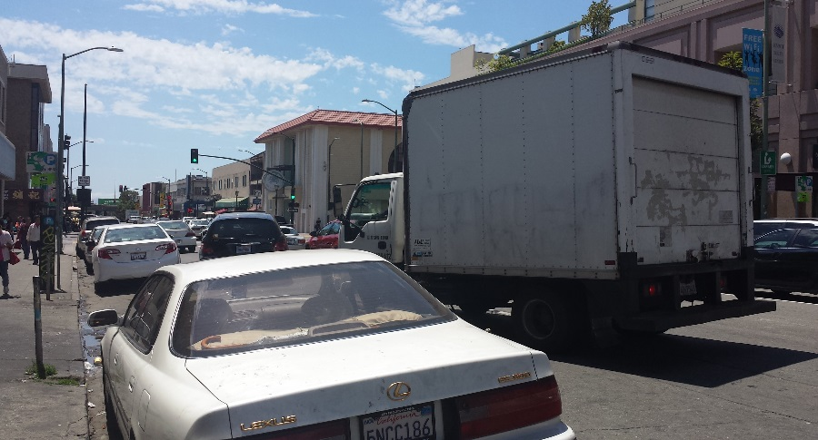
What’s At Risk?
Local Street and Road Funding
City Total: | >$60 million
County Total: | >$42 million
Grand Total: | $102,631,726
Jurisdictions Funded | Existing State Funding* ($ x 1,000) | New SB 1 Funding* ($ x 1,000)
Alameda | $1,854 | $1,344
Albany | $448 | $320
Berkeley | $2,801 | $2,032
Dublin | $1,345 | $972
Emeryville | $280 | $199
Fremont | $5,343 | $3,887
Hayward | $3,709 | $2,695
Livermore | $2,060 | $1,494
Newark | $1,050 | $758
Oakland | $9,840 | $7,167
Piedmont | $268 | $190
Pleasanton | $1,754 | $1,271
San Leandro | $2,050 | $1,486
Union City | $1,707 | $1,236
County of Alameda | $25,839 | $17,232
 | $60,348 | $42,283
* Represents increase expected in FY2018-19 with new vehicle fee, phasing in of
taxes and adjustment of variable excise tax rate.
Data Source: http://californiacityfinance.com/
TOTAL STATE FUNDING: $102,631
Notes:
SB 1 enables cities and counties to address significant maintenance, rehabilitation and safety needs on the local street and road system.
SB 1 generates over $5 B annually for state and local transportation improvements. Cities and counties are slated to receive $1.5 B annually at full implementation of
SB 1 (in 2020). In Alameda County, this means over $40 M each year for pothole repairs, bridge safety, road maintenance, sidewalk improvements and traffic
signal modernization.
SB 1 provides funding for every community to rehabilitate, repair, and maintain local streets and roads, make critical, life-saving safety improvements, repair and replace aging bridges and culverts, reduce congestion and increase mobility options including bicycle and pedestrian facilities. On top of that, Caltrans will receive
$1.5 B to repair freeways statewide.
There are 96 projects in Alameda County that have been approved by the California Transportation Commission for construction in FY2018-19
87 city projects
9 county projects
Collectively the jurisdictions in Alameda County will receive a 70% increase in NEW money each year, which is almost half a billion dollars in 10 years that will evaporate if SB 1 goes away.
NEXT SLIDE

Slide 9
What’s At Risk? Transit Funding
More than $58 million is estimate in FY2018-19 for state transit funding, including $34 million
per year in new transit operations and maintenance funding.
Alameda County Transit Operators | Existing State Transit Operating Funds** ($ x 1,000) | New SB 1 Operating Funds ($ x 1,000) | New SB 1 State of Good Repair Program ($ x 1,000) | Total New SB 1 Funding ($ x 1,000) | Overall Total ($ x 1,000)
AC Transit | $8,309 | $8,309 | $3,149 | $11,459 | $19,768
BART | $16,098 | $16,098 | $6,102 | $22,201 | $38,299
LAVTA | $147 | $147 | $56 | $202 | $349
Union City | $45 | $45 | $17 | $62 | $107
ACE (Alameda County) | $99 | $99 | $37 | $136 | $234
TOTAL | $24,698 | $24,698 | $9,361 | $34,060 | $58,758
** Source: State Transit Assistance Funds.
Notes:
Additional transit operating funds allows service to continue or expand.
State of Good Repair program allows transit agencies to not only repair their fleet, but their supporting infrastructure.
More than $58 M is estimated in FY2018-19 for state transit funding for Alameda County transit operators including over $34 M per year in new transit operations and maintenance funding for Alameda County operators. Our transit operators will use the funds in several ways, for example:
AC Transit
Modernize service and upgrade transit facilities
Replace diesel-powered buses with low or zero-emission buses
Rehabilitate customer service center
AC Transit was awarded $29 M in SB 1 funds in May to purchase hybrid buses
BART
Upgrading and updating its nearly half-century old infrastructure, and run longer trains more frequently into San Francisco, increasing capacity by 40%.
Purchase new Fleet of the Future rail cars, modernization of BART’s train control system and the expansion of the modernized maintenance facility in Hayward.
BART-to-Silicon Valley to extend service into San Jose and Santa Clara.
BART was awarded funding for these projects in May and more than half of that funding would be lost if SB 1 is repealed
LAVTA
Bus stop improvements throughout the service area
Improving the customer-service experience at transit hubs
Maintaining bus service in lower-income communities
LAVTA was awarded over $20 M for a Dublin/Pleasanton Capacity Improvement and Congestion Reduction Program
NEXT SLIDE

Slide 10
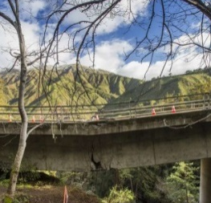
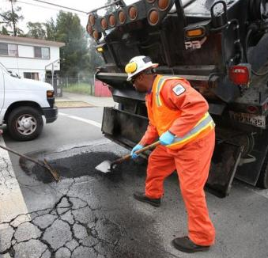
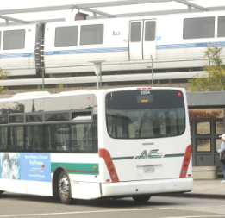
What’s At Risk?
Major Congestion Relief Projects
HIGHWAY AND BRIDGE SAFETY
Measure BB and SB 1 are working together to fund projects on every highway in Alameda County to:
Repair roads and fix potholes
Improve safety
Modernize signals
ROAD REPAIRS
Potholes, poor striping and deteriorated roads cause unsafe conditions, accidents and costly repairs. Measure BB and SB 1 local streets and roads maintenance funding work together to:
Repair roads and fix potholes
Improve safety
Modernize signals
TRANSIT OPERATIONS AND MAINTENANCE
Every transit operator in Alameda County benefits from both SB 1 and Measure BB funding to:
Deliver expanded transit services
Maintain transit vehicles
Improve stations and cleanliness
Support reliable services
Notes:
Alameda CTC has already identified a list of projects that will benefit from SB 1 by leveraging Measure BB dollars as shown on this table.
Projects include highway and bridge safety, road repairs, and transit operations
and maintenance.
SB 1 gives cities and counties an opportunity to catch up on years of unfunded maintenance needs that have plagued our roadways and cost drivers for years and allows local Measure BB dollars to have more buying power.
SB 1 funding allows cities and counties to accelerate the delivery of projects that have been on the books for years, but couldn’t move forward due to lack of funding. Our goal is to maintain roads and address small problems immediately, so they don’t get worse and cost more to fix later.
NEXT SLIDE

Slide 11
SB 1 Potential Capital Project Investments
Project | Target to Begin Construction | Estimated Construction Cost* ($ x million)
Go Port: 7th Street Grade Separation and Port Arterial Improvements | 2019 | $395
I-80 Gilman Interchange Improvements | 2021 | $45
East Bay Greenway (Lake Merritt BART to South Hayward BART) | 2021 | $200
I-80 Ashby (SR-13) Interchange Improvements | 2022 | $45
Oakland/Alameda Access Project | 2022 | $90
I-680 Sunol Express Lanes (Phase II) | 2022 | $115
Alameda County Grade Crossing Program | 2022 | $665
I-680 Express Lanes from SR-84 to Alcosta Boulevard | 2023 | $435
I-880 Interchange Improvements (Whipple Road/Industrial Parkway Southwest and Industrial Parkway) | 2023 | $125
Dublin Boulevard – North Canyons Parkway Extension | 2023 | $95
I-880 Interchange Improvements (Winton Avenue/A Street) | 2024 | $90
San Pablo (SR-123) Multimodal Corridor | 2024 | $310
East 14th Street/Mission and Fremont Boulevard Multimodal Corridor | 2024 | $380
SR-262 (Mission Boulevard) Cross Connector | 2025 | $600
 |  | $3,590
*Dollars shown reflect the mid-point of construction. Full funding is assumed.

Slide 12
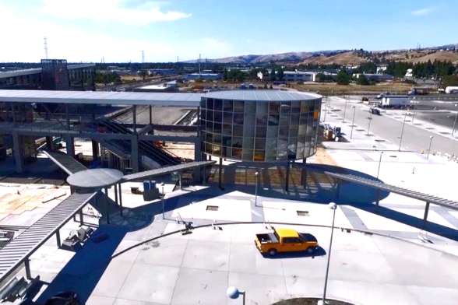
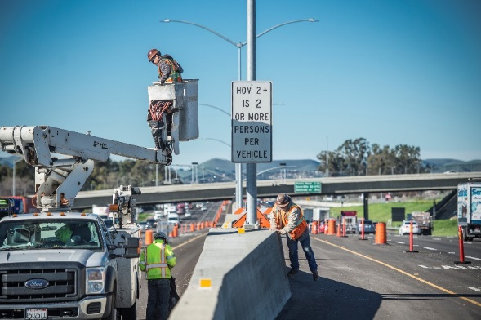
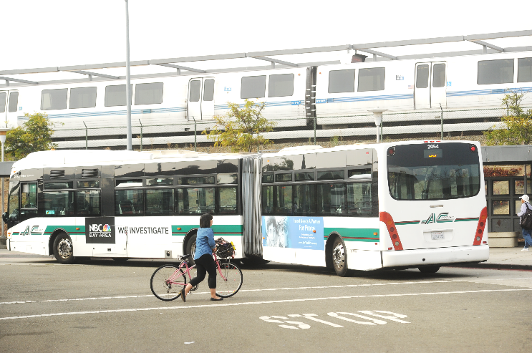
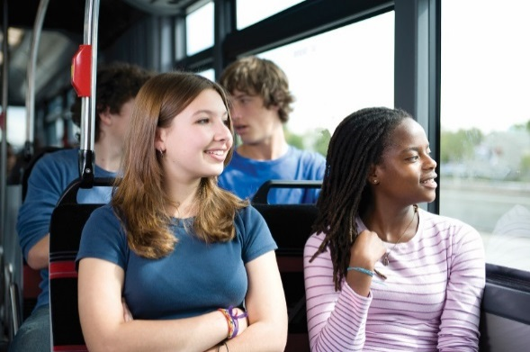
We’ve Delivered in Alameda County
Since 2000, Alameda CTC has leveraged $2.6 billion
in external funds with our local $1.5 billion to
invest over $4.1 billion
along the highway
corridors in the County
to improve mobility
and connectivity
Notes:
Since 2000, Alameda CTC has leveraged $2.6 B in external funds with our local $1.5 B to invest over $4.1 B along the highway corridors in Alameda County to improve mobility and connectivity.
NEXT SLIDE

Slide 13
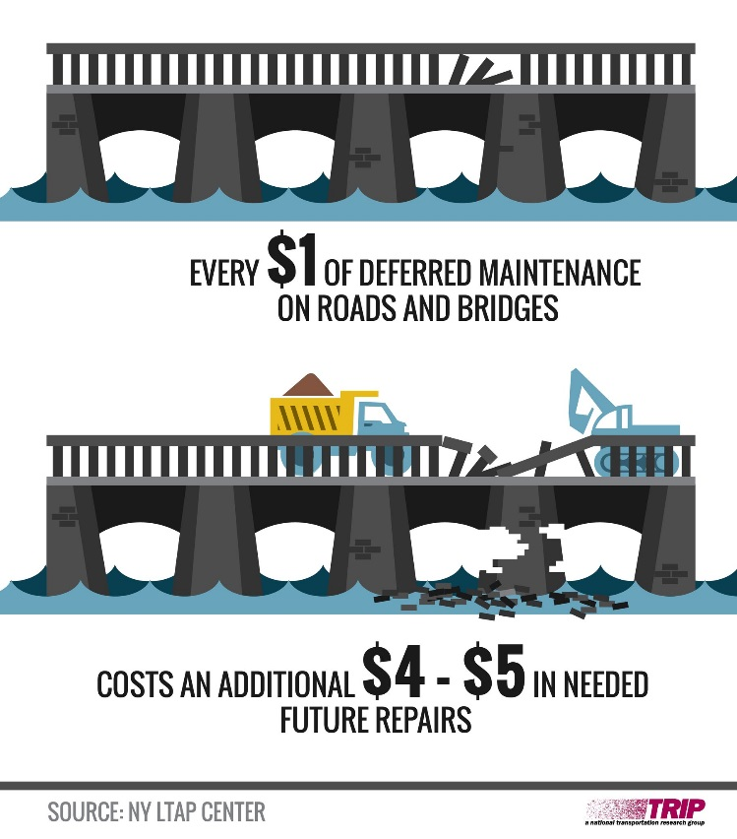
The Cost
Californians pay an average of $762 per year in vehicle repair and maintenance due to bad roads
The cost to repair a road in bad condition
is exponentially higher than to maintain a
road in good condition
Pay now or pay later
Data Source: Trip Report, August 2018
Notes:
‘How much is it going to cost me’ is the first question that most people ask.
Californians on average pay $762 per year in vehicle repair and maintenance due to bad roads
The cost to repair a road in bad condition can be up to 8 times what it costs to maintain a road in good condition
Pay now or pay later
NEXT SLIDE

Slide 14
SB 1 Costs Less Than $10 per Month
Average cost per driver
California’s 26 million licensed drivers consume 15.5 billion gallons of
fuel per year
  577 gallons per driver
  12 cents per gallon
  $69.24 average fuel cost
Annual average cost per driver
  Average vehicle registration fee is $47.85
  Average fuel consumption equals $69.24
  Average total costs per driver is $117.09 per year (or $9.76 per month)
Data Source: http://www.counties.org/
Notes:
The California Department of Finance calculated that the average cost to motorists is less than $10/month.
Registration: Nearly 50% of all registered vehicles in California are valued at less than $5,000. 40% are valued at less than $25,000. Thus, the average annual amount for vehicle registration is approximately $48.
Fuel: California’s 26 million licensed drivers consume 15.5 billion gallons per year. That is 577 gallons per driver, multiplied by 12 cents per gallon is $69.24 each.
Annual average cost per driver is:
Vehicle Registration $47.85
Fuel $69.24
Total $117.09 per year OR $9.76 per month
Source: California State Association of Counties: SB 1 Frequently Asked Questions and Answers http://www.counties.org/sites/main/files/file-attachments/sb_1_qa_for_local_agency_final.pdf
NEXT SLIDE

Slide 15
What’s at Stake?
Passage of Proposition 6 puts projects at risk delaying projects that provide maintenance and safety indefinitely
Over $40 million per year in road
maintenance funds would vanish from
city and county budgets
State highway funding would be lost
Over $30 million per year in transit funding
in Alameda County would be eliminated

Slide 16
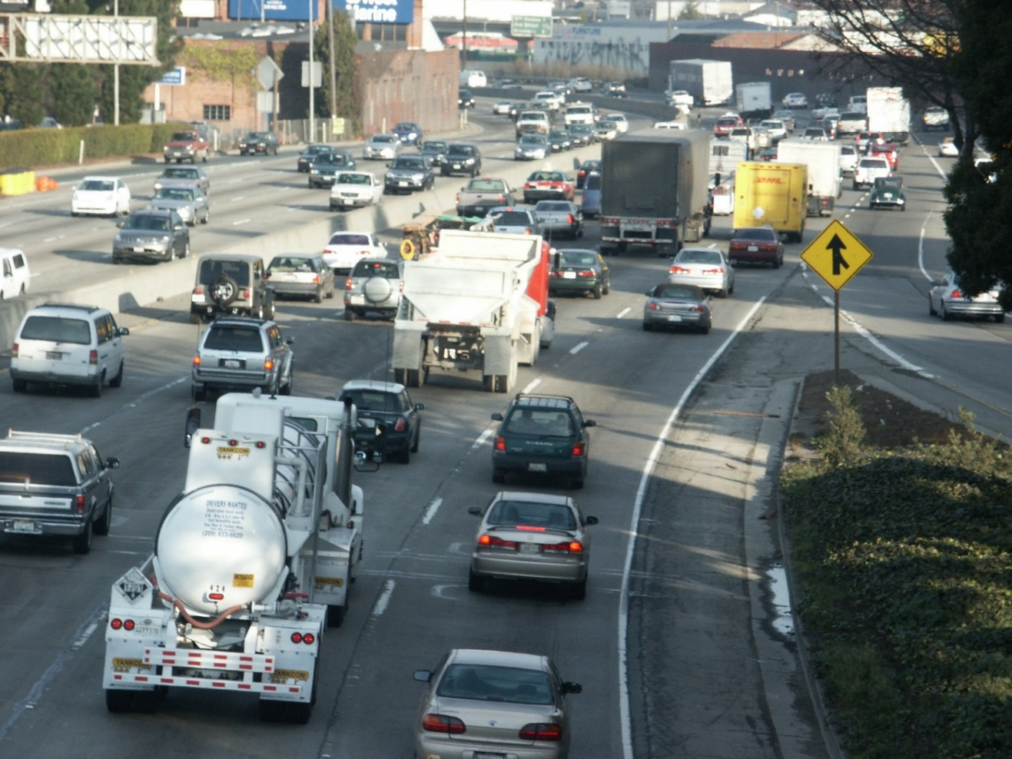
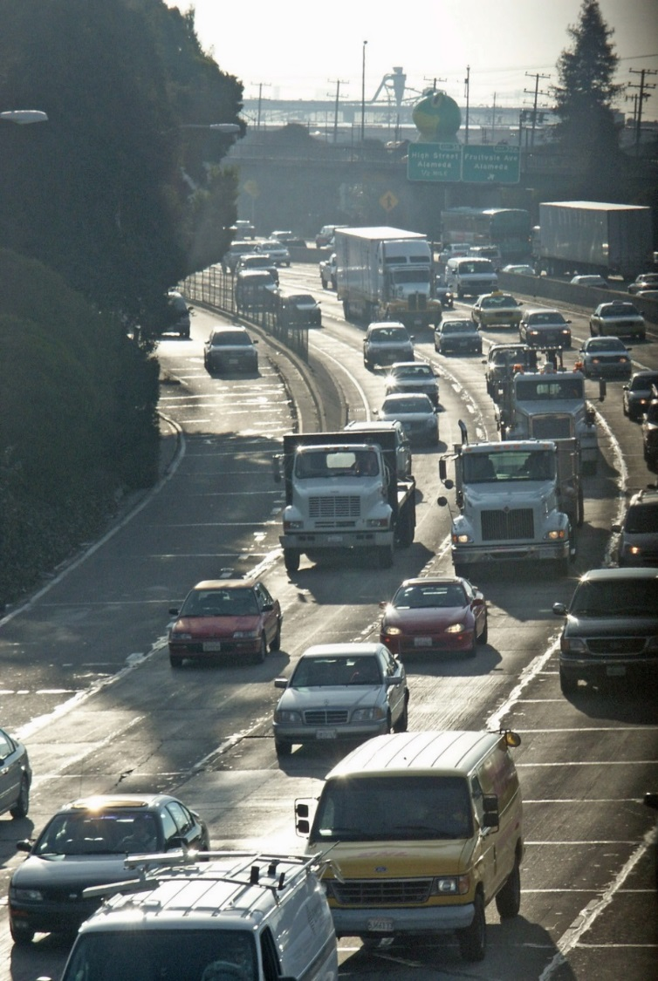
Gridlock

Slide 17
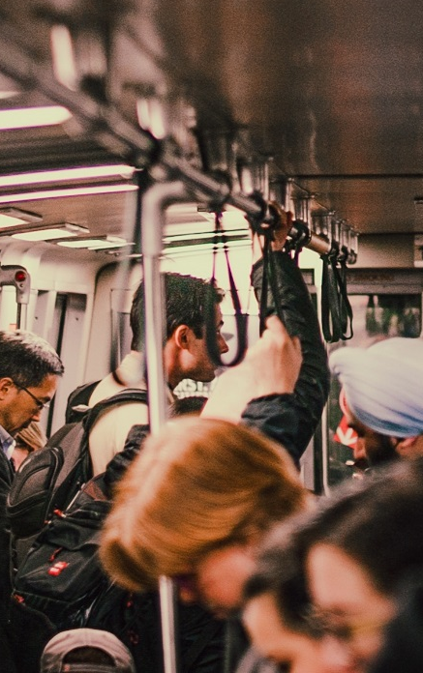
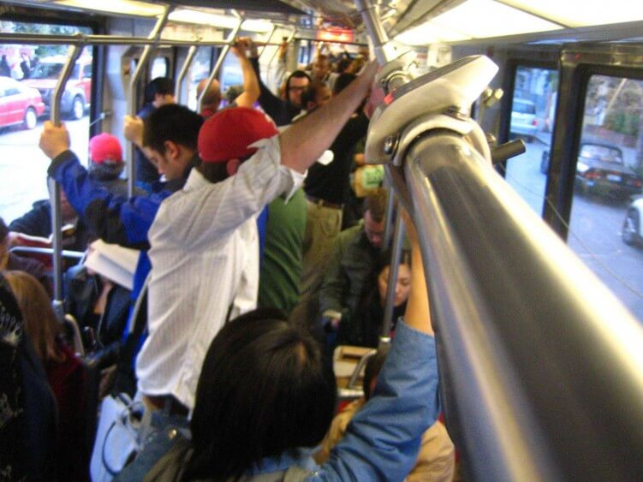
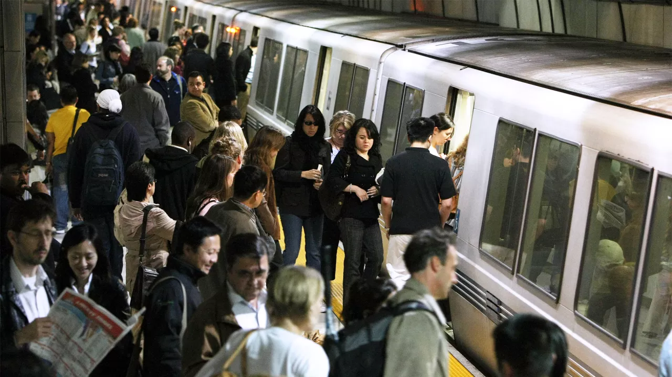
Transit Overcrowding

Slide 18
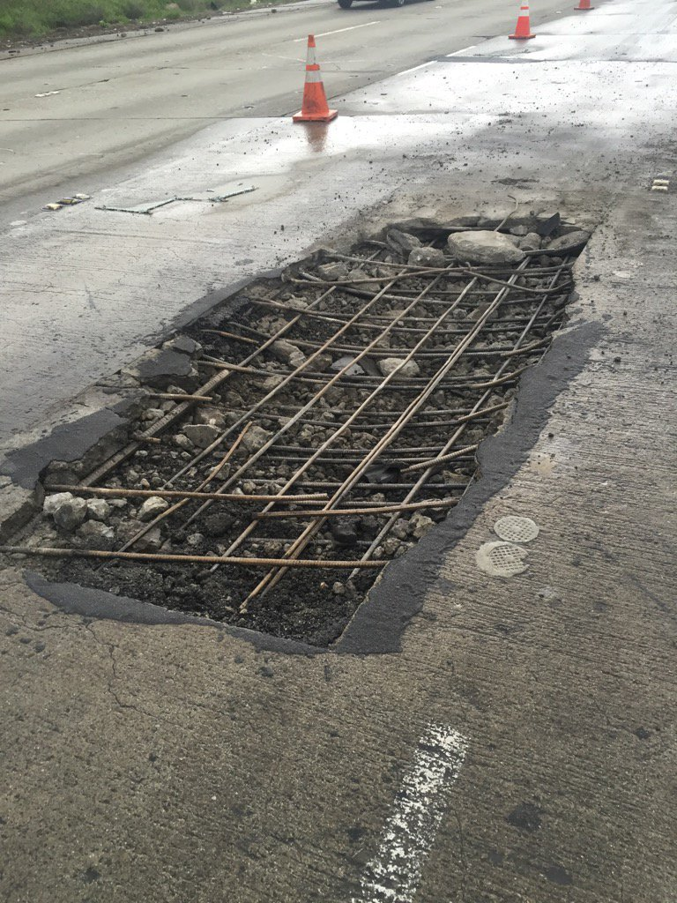
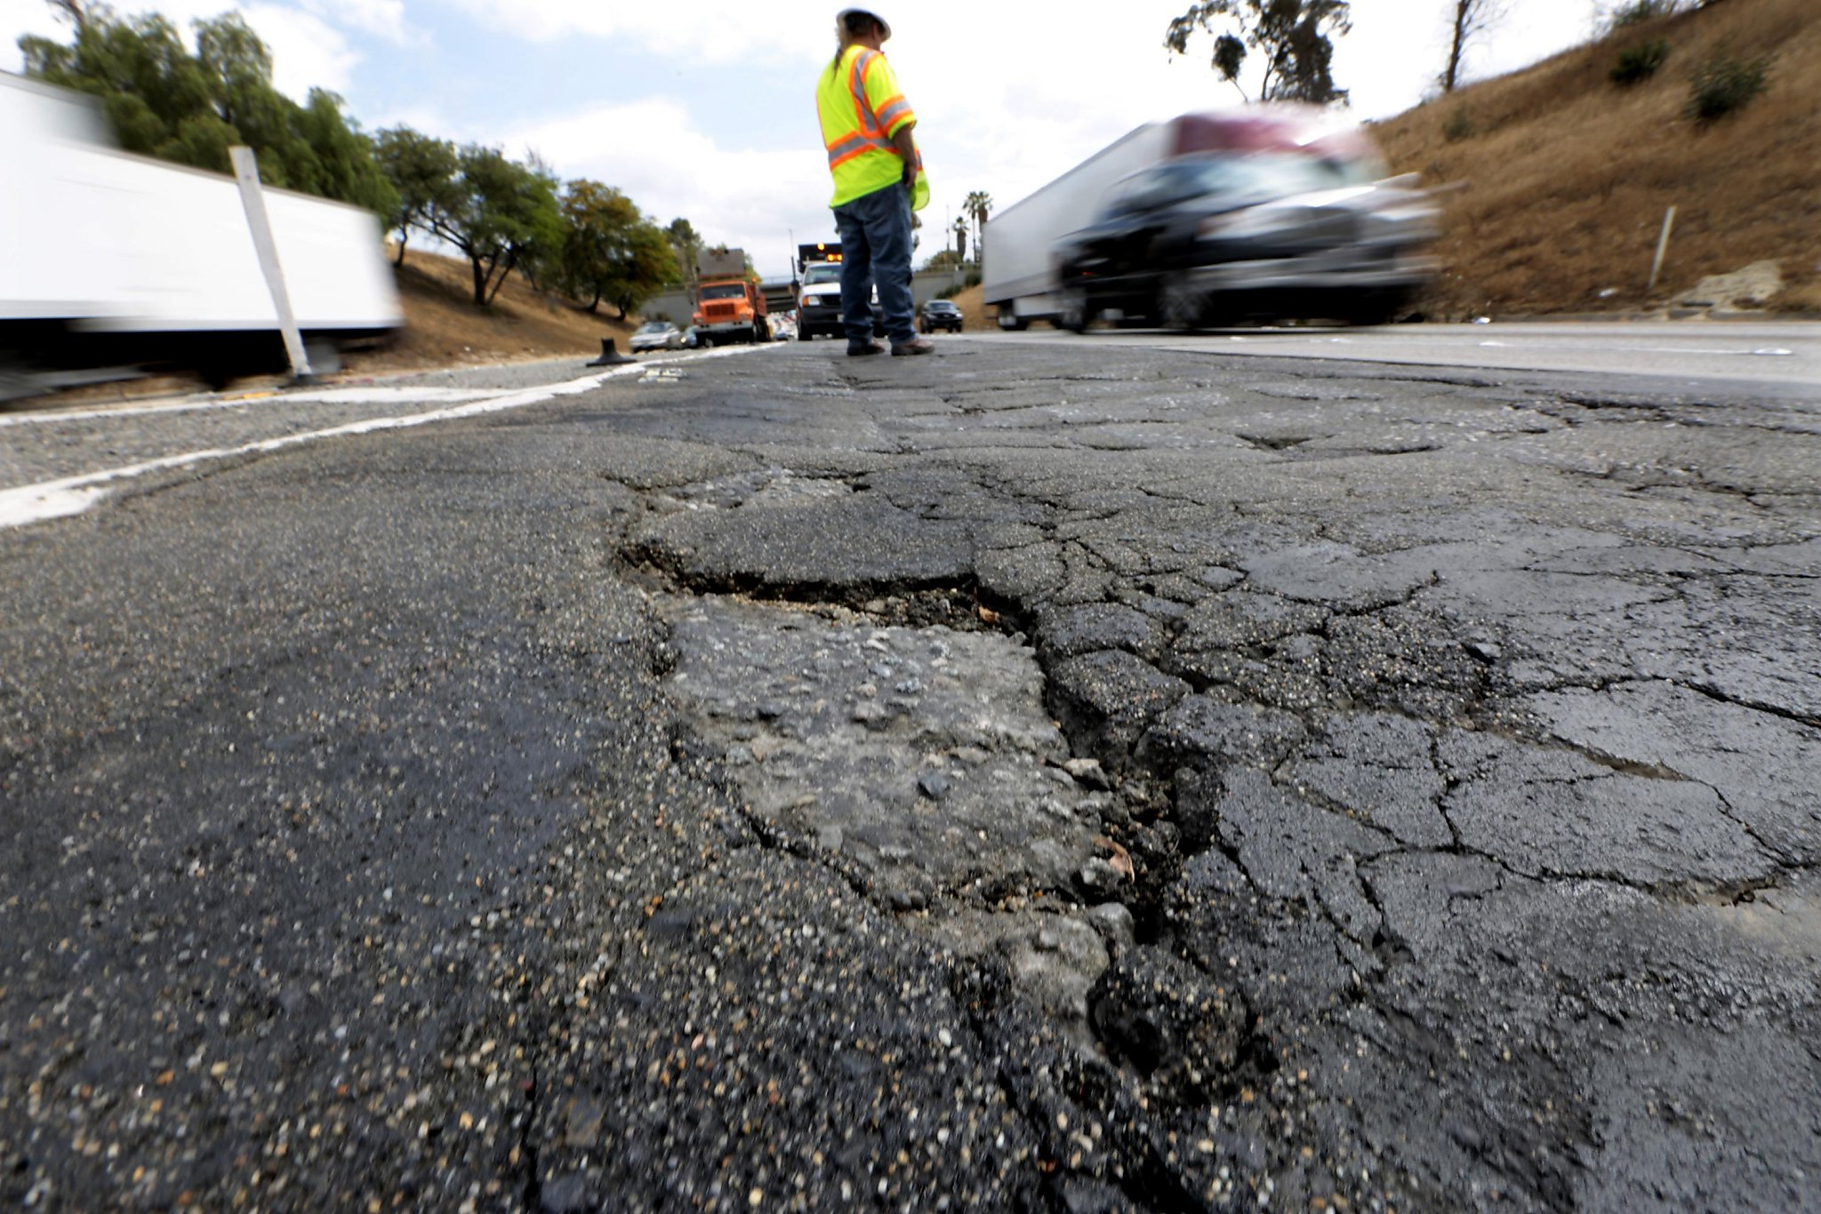
Potholes

Slide 19
Thank You
Alameda County Transportation Commission • 1111 Broadway, Suite 800
Oakland, CA 94607 • 510.208.7400

