Slide 1
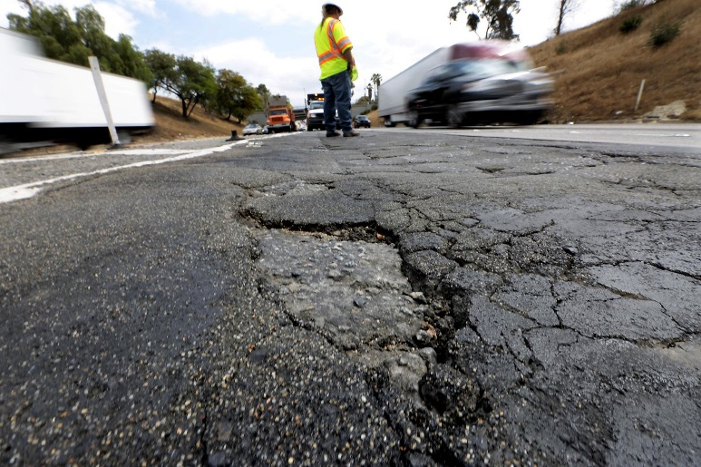
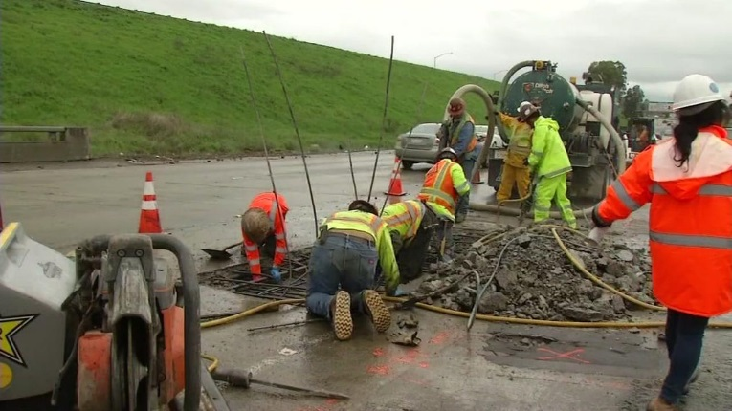
Transportation Solutions
in the City of Emeryville
Senate Bill 1 Infrastructure Investments At Risk With Proposition 6
Essential funding for transportation programs and projects throughout Alameda County is provided through Senate Bill 1 (SB 1) and will generate over $2 million for road repairs and maintenance over the next 10 years for the City of Emeryville, facilitating faster
project delivery.
ROAD REPAIRS ADVANCE IN THE CITY OF EMERYVILLE
The City of Emeryville’s San Pablo Avenue Mid-Block Cross Walk project will deliver added safety by constructing:
New pedestrian ramps in compliance with the Americans with Disabilities Act (ADA).
A new pedestrian refuge area in the median.
Installing highly visible pedestrian/vehicular traffic control devices motorists and create bicycle facilities.
FUNDING SOLUTIONS
SENATE BILL 1 (SB 1)
In April 2017, Governor Jerry Brown signed into law SB 1, the Road Repair and Accountability Act of 2017. This landmark funding program increased the gas tax, diesel tax and vehicle registration fees to invest approximately $5.4 billion annually
in state and local roads, goods movement, public transit and active transportation programs.
ANNUAL STATEWIDE SB 1 FUNDING
$1.5 Billion: state highway operations protection program administered
by Caltrans
$400 Million: state bridge maintenance
and repairs
$1.5 Billion: local streets and roads
$750 Million: mass transit
$300 Million: goods movement and
freight projects
$250 Million: congested corridors and
relief management
$200 Million: the local partnership
program to match locally generated transportation funds
$100 Million: Active Transportation Program
PROPOSITION 6 PUTS SB 1 FUNDING AT RISK IN THE COUNTY
The measure to repeal SB 1 through a constitutional amendment will be on the November 2018 ballot as Proposition 6. If successful, it will:
Eliminate over $40 million per year in road maintenance funds from city and county budgets.
Eliminate all SB 1 funding designated for state highways.
Eliminate more than $30 million per year in transit funds in
Alameda County.
Require any measure enacting specified taxes or fees on gas or diesel fuel, or on the privilege to operate a vehicle on public highways, to be submitted to the electorate for approval.
Potentially lower future transportation tax revenues.
Alameda County projects to improve highways, rail, goods movement, roads, bridges, trails and pedestrian safety could be delayed indefinitely with elimination of SB 1 funding.
20180831

Slide 2
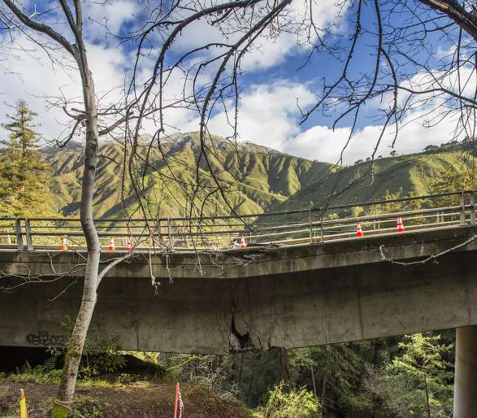
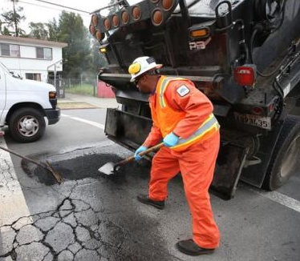
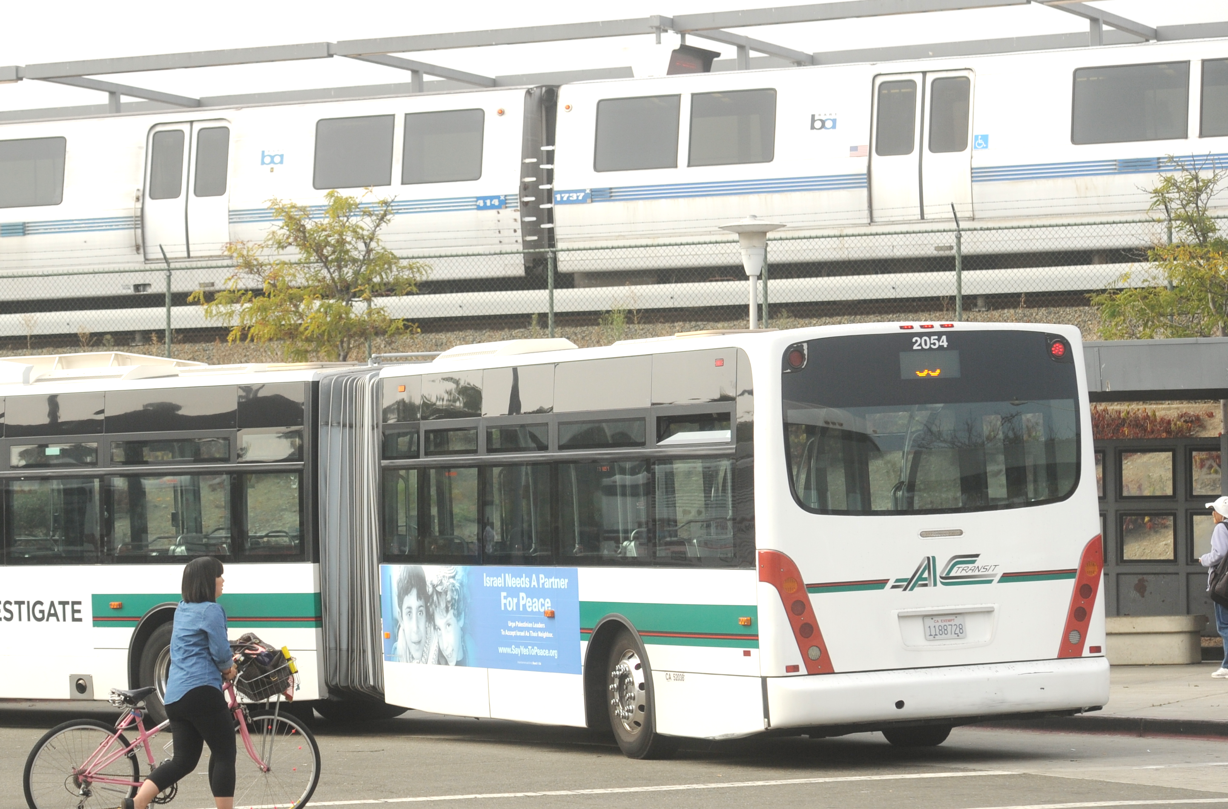
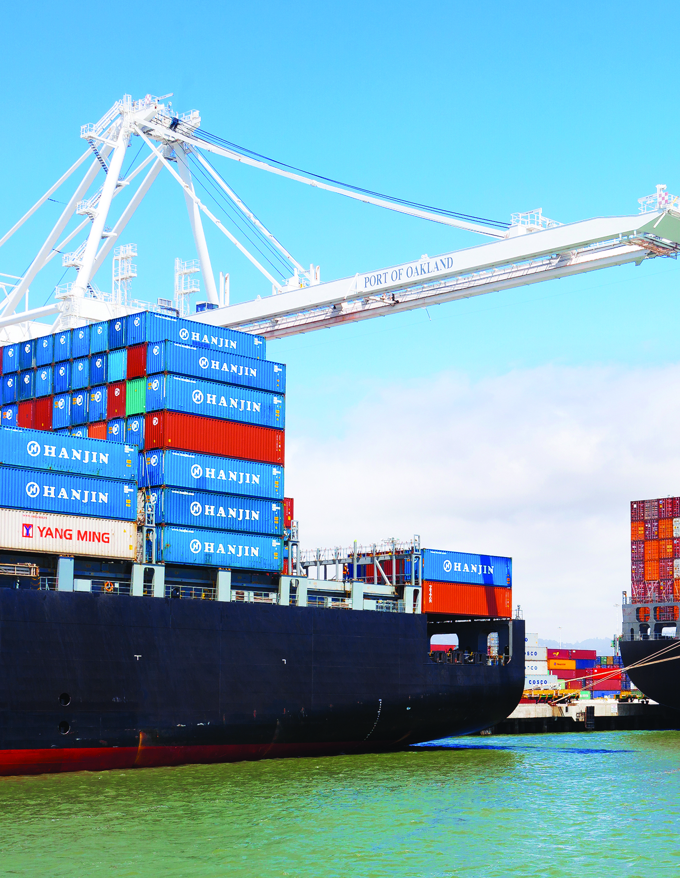
TRANSPORTATION SOLUTIONS IN THE CITY OF EMERYVILLE
SB1 ACCOUNTABILITY AND TRANSPARENCY
Strict accountability and transparency along with performance measures ensures safe and efficient delivery.
SB 1
  Cities and counties must adopt and submit to the state a planned list of projects and year-end reporting that accounts for every dollar of SB 1 revenue received.
  SB 1 establishes an independent Inspector General appointed by
  the Governor to oversee programs
  to ensure all funds are spent
  as promised and reports annually.
PROTECTION OF FUNDS
The State and counties have long relied on “user fees,” fuel taxes and vehicle charges, to maintain transportation infrastructure. Diversion of those funds created a backlog of road and bridge repairs. Proposition 69, approved by voters in June 2018, created a “lockbox” to ensure that all SB 1 funding is dedicated for transportation-related purposes only.
Proposition 69
  Prohibits the diversion of funds.
  Prohibits revenue from new vehicle license fees form being used to repay general obligation bond debt.
  Exempts new revenues from state and local spending limits.
FUNDING AT RISK
Proposition 6: SB 1 Repeal Effort
  If approved on the November 2018 ballot, it would:
  Eliminate all SB 1 funding sources
  and reduce transportation
  funding statewide.
  Require any measure enacting specified taxes or fees on gas or diesel fuel, or on the privilege to operate a vehicle on public highways, to be submitted to the electorate for approval.
  Potentially lower future transportation
  tax revenues.
Transportation Projects At Risk
SB 1 is a new revenue stream to support projects currently funded by Measure BB – a measure approved overwhelmingly by Alameda County voters anticipated to generate over $8 billion for essential transportation improvements in every city and throughout the County, serving as a down payment to attract regional, state and federal funds to deliver projects, supporting local jobs and the economy. Together, Measure BB and SB 1 can deliver projects faster. However, if Proposition 6 on the November
ballot passes …
HIGHWAY AND BRIDGE SAFETY will be at risk with the County loosing funding for projects on every highway to:
Improve highway safety
Repair and repave highways
Repair bridges
Reduce collisions
Improve traveler information
ROAD REPAIRS will be at risk and unsafe conditions, accidents and costly repairs could worsen because of reduced funding for:
Road repair
Potholes repair
Safety modernization
Signals modernization
TRANSIT OPERATIONS AND MAINTENANCE will be at risk by reduced funding to:
Deliver expanded transit services
Maintain transit vehicles
Improve stations and cleanliness
Support reliable services
The County’s GOODS MOVEMENT AND ECONOMIC ACTIVITY will be at risk at some of the world’s most strategic trade locations – the Port of Oakland, Oakland International Airport and highways of national freight significance. The County would lose funding for:
Delivery of roadway and rail safety improvements at the Port of Oakland
Installing smart technology to deliver goods more safely and efficiently
Installing railroad crossing safety improvements in cities throughout Alameda County
Alameda County Transportation Commission 1111 Broadway, Suite 800 Oakland, CA 94607 510.208.7400 www.AlamedaCTC.org

