Slide 1
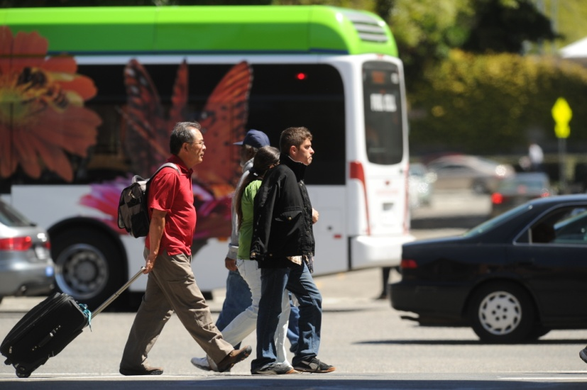

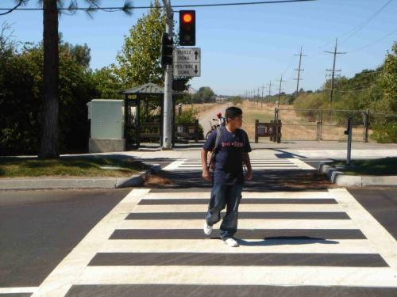
[Jurisdiction’s] Draft
Complete Streets Policy Resolution
[Jurisdiction] [City Council/Board of Supervisors]
[Date]

Slide 2
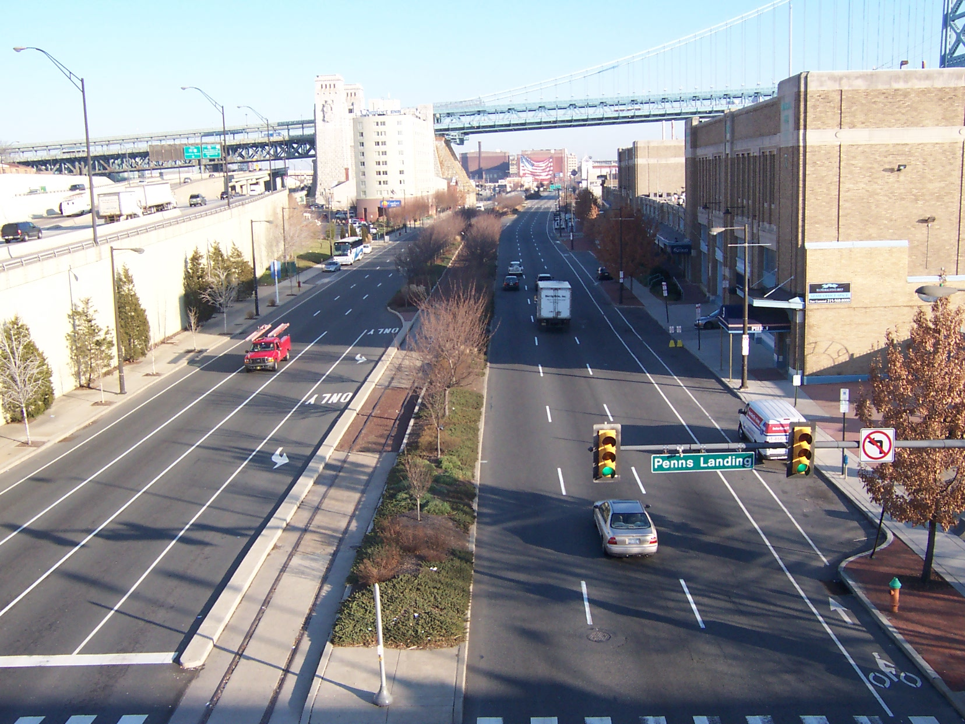
What are Complete Streets?
Complete Streets are safe, comfortable, and convenient for travel for everyone, regardless of age or ability – motorists, pedestrians, bicyclists, and public transportation riders.

Slide 3
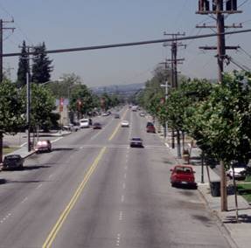
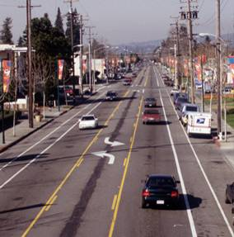
San Leandro Road Diet
Before
After
Notes:
Accommodates bicyclists, pedestrians, transit

Slide 4
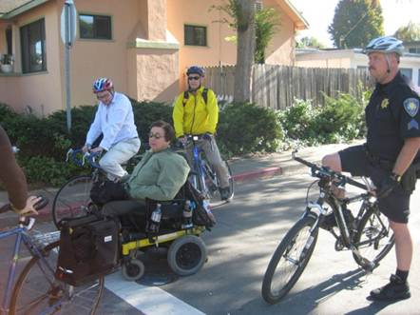
Complete Streets Serve All Users
Pedestrians
Bicyclists
Transit Users
Motorists
Goods Movement
People with Disabilities
People of All Ages & Abilities
Emergency Responders

Slide 5
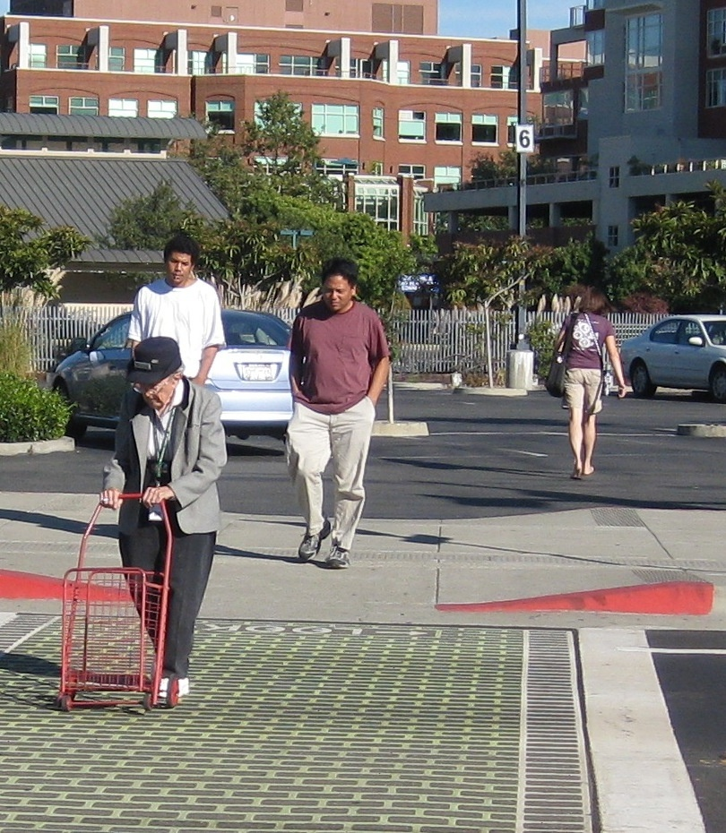
Benefits of Complete Streets
Improved safety
Increased mobility for all users and modes
Improved air and water quality
Improved public health
Enhanced economic competitiveness
Increased livability

Slide 6
Improved Safety
Bicyclists and pedestrians are disproportionately represented in crash rates
Designing streets for all users reduces crashes
  In Santa Monica, a street reconfiguration reduced crashes by 65%¹
California Highway Patrol 1998 to 2007 Bay Area Collisions; American Community Survey Work Trips (2009)
Notes:
The collision rate for pedestrians and bicyclists is significantly higher than for automobile trips, due to incomplete streets.
Santa Monica street reconfiguration involved parallel parking, a center turn lane, and bike lanes
Source:
National Complete Streets Coalition and Local Government Commission. 2012. Complete Streets in California: It’s a Safe Decision.

Slide 7
Increased Transit Ridership
Sidewalks and crossings encourage transit use
  Walkable neighborhoods of King County, WA have higher public transportation shares²
Improving efficiency and reliability makes transit more appealing
  A priority signal system in Los Angeles decreased travel time by 25% and increased ridership by more than 30%³
Notes:
Complete Streets support your community’s investment in transit. Crosswalks and sidewalks near transit stops promote transit use. As every transit trip requires crossing the street either coming or going, crosswalks are essential to encouraging access to the bus.
Complete Streets include elements such as signal timing, which improves efficiency of the bus system. A Complete Streets policy enables decision makers to prioritize transit in roadway improvements – making trips faster and more reliable, improving its appeal over driving in your own car.
Sources:
2. Lawrence Frank and Company, Inc. 2005. A Study of Land Use, Transportation, Air Quality, and Health (LUTAQH) in King County, WA.
3. Los Angeles County Metropolitan Transportation Authority. 2002. Metro Rapid Demonstration Program, Final Report.

Slide 8
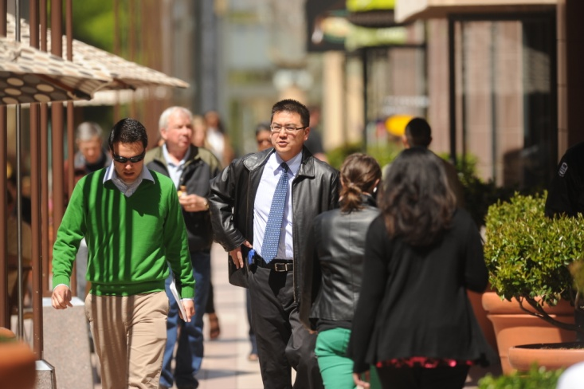
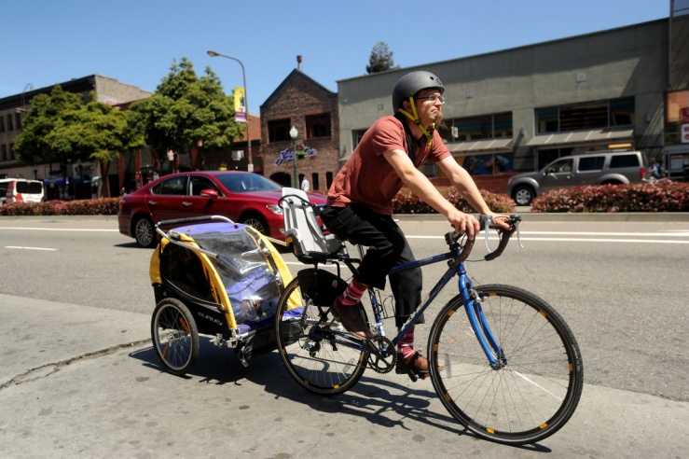
Increased Walking and Bicycling
Pedestrian facilities encourage walking
  Residents are 65% more likely to walk in a neighborhood with sidewalks⁴
Bicycle facilities encourage biking
  Cities with more bike lanes per square mile have higher levels of bicycle commuting⁵
  San Francisco’s improvements on Valencia Street resulted in 1.4 times more cyclists and 36% fewer pedestrian collisions¹
Notes:
There is a tremendous amount of evidence that when you put in sidewalks people will walk, and when you put in bike facilities, people will bike.
Sources:
4. Giles-Corti, B., & R.J. Donovan. 2002. The relative influence of individual, social, and physical environment determinants of physical activity. Social Science & Medicine, 54 1793-1812.
5. Dill, J. & T. Carr. (2003). Bicycle Commuting and Facilities in Major US Cities: If You Build Them, Commuters Will Use Them. Transportation Research Record:, No. 1828, TRB, pp 116-123.
1. National Complete Streets Coalition and Local Government Commission. 2012. Complete Streets in California: It’s a Safe Decision.
8

Slide 9
Growth in Walking and Biking in Alameda County
Walking represents 11% of all trips, and 2% of trips are completed by bike in Alameda County (2000).
Percent Change in PM Pedestrian Counts Relative to 2002
Percent Change in PM Bicycle Counts Relative to 2002
Source: Census 2000 and Alameda County Transportation Commission Bicycle & Pedestrian Surveys

Slide 10
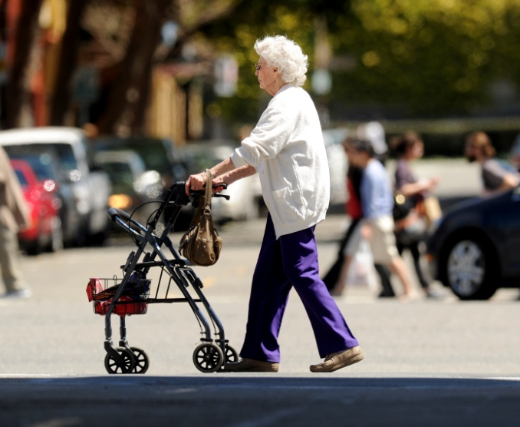
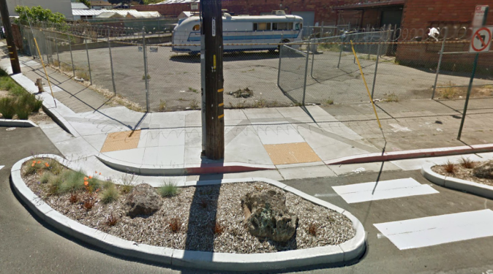
Increased Mobility for People with Disabilities and Older Adults
Older pedestrians are more at risk
  In 2008, older pedestrians represented 18% of the fatalities but were only 13% of the population nationwide⁶
Seniors are more isolated
  Non-driving seniors make 65% fewer trips to visit family, friends or go to church⁷
Pedestrians with disabilities require additional design consideration
  Blind pedestrians wait three times longer to cross the street than sighted pedestrians⁸
Notes:
Complete Streets reduce isolation and dependence for older adults and pedestrians with disabilities. Design for all users enables everyone to get to the store, to the bus stop, and to access essential services.
Sources:
6. National Highway Traffic Safety Administration’s National Center for Statistics and Analysis. 2009. Traffic Safety Facts: 2008 Overview.
7. Surface Transportation Policy Project. 2004. Aging Americans: Stranded Without Options.
8. Ashmead, D.H., et al. 2005. Street Crossing by Sighted and Blind Pedestrians at a Modern Roundabout. Journal of Transportation Engineering, 131 (11): 812-821.

Slide 11
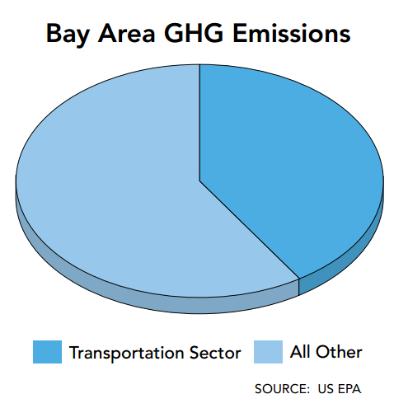
Reduced Air Pollution from Transportation
Transportation is a major source of air pollution
  75% of air pollution emissions in the Bay Area are from mobile sources (particularly cars & light duty trucks)⁹
Many trips could be walkable or bikeable
  40% of all trips are < 2 miles
Notes:
Complete Streets support State and regional air quality goals.
Source:
9. Bay Area Air Quality Management District. 2007. Source Inventory of Greenhouse Gas Emissions.

Slide 12
Reduced Obesity
Obesity is lower in places where people use bicycles, public transportation, and their feet¹⁰
Source: Pucher, “Walking and Cycling: Path to Improved Public Health,” Fit City Conference, NYC, June 2009
Notes:
Complete Streets allow people to get exercise without going to the gym; people can walk to the store or to the bus stop.
Source:
10. Pucher, J. 2009. Walking and Cycling: Path to Improved Public Health. Fit City Conference, NYC.
12

Slide 13

Healthier Children
Nationally, fewer than one-third of children participate in 20 minutes of physical activity¹¹
Safe Routes to Schools, which is part of Complete Streets, is growing in Alameda County
Notes:
Complete Streets support SR2S efforts by supporting infrastructure and policies to help children walk and bike to school. This includes providing adequate walking and biking facilities near schools as well as policies supporting neighborhood schools.
Sources:
11. National Association for Sport and Physical Education. 2010. Shape of the Nation Report.
Alameda County SR2S data: Alameda County Safe Routes to Schools 2011-2012 Year-End Report

Slide 14
State, Regional, and County Policy Requirements
Federal
State
Caltrans DD64 R-1
State
CA Complete Streets Act of 2008
Regional
OBAG Local Resolution by January 2013
Regional
Complete Streets
Checklists
Regional
Compliance with State Requirement by 2014
County
TEP: Complete Streets in All Projects
County
Master Funding Agreement: Policy by June 2013
Notes:
There are three complete streets requirements in place today that impact Alameda County jurisdictions:
State: California Complete Streets Act of 2008 (Assembly Bill 1358)
This law, which took effect in January 2011, requires cities and counties to include complete streets policies as part of their general plans so that roadways are designed to safely accommodate all users. This must be done at the time that any substantive revisions of the circulation element in the general plan are made.
Regional: MTC requires that any jurisdiction receiving OBAG funding must, by January 31, 2013, either adopt a complete streets policy resolution that is consistent with regional guidelines, or have a general plan circulation element that is in compliance with the state Complete Streets Act. MTC has developed nine policy elements that must be included in a resolution
County: The current Master Program Funding Agreements (MPFA’s) between Alameda CTC and all local jurisdictions in Alameda County, which allows the distribution of local sales tax pass-through funding, includes a complete streets policy requirement. Local jurisdictions must have an adopted complete streets policy, or demonstrate that a policy is being developed and will be adopted, by June 30, 2013 (however, due to the earlier MTC deadline of Jan 2013, the Alameda CTC deadline is essentially Jan 2013.) In addition the MPFAs require that jurisdictions comply with the state Complete Streets Act. There is no Alameda CTC deadline for this action.
In addition to these existing complete streets requirements, there are several possible future requirements, as well. The TEP, which will be on the November ballot, includes a complete streets requirement for all projects included in the TEP.
Although there is currently no federal complete streets requirement in the newly adopted federal transportation bill, one was proposed in the draft bill, indicating that in the future there could be a federal requirement.

Slide 15
Complete Streets Policy Requirements
Complete Streets Policy Resolution Required for Regional and Local Funding:
Agency | Funding | Deadline
MTC | One Bay Area Grant (OBAG) | January 31, 2013
Alameda CTC | Measure B pass-through funds and vehicle registration fee funds | January 31, 2013 (to comply with MTC deadline)

Slide 16
Policy Resolution: 10 Elements Needed to Comply with Alameda CTC and MTC Requirements
Vision
All Users and Modes
All Projects/Phases
Exceptions
Network/ Connectivity
Jurisdiction
Design
Context Sensitivity
Performance Measures
Implementation Next Steps
Notes:
See adopted Alameda CTC required policy elements for descriptions of each element.

Slide 17
1. Vision
[Insert language from your resolution that addresses this element.]

Slide 18
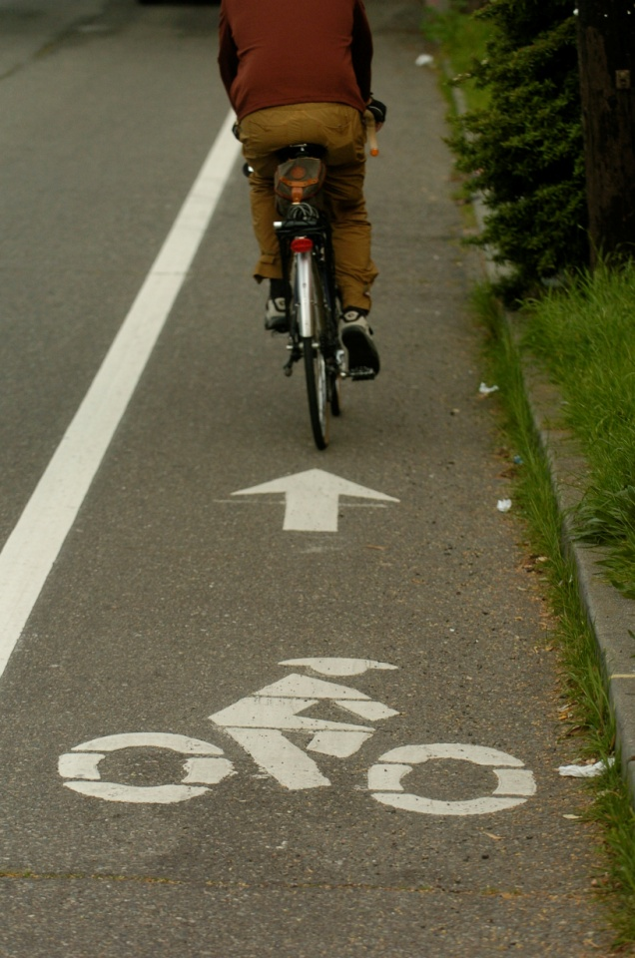
2. All Users and Modes
[Insert language from your resolution that addresses this element.]

Slide 19
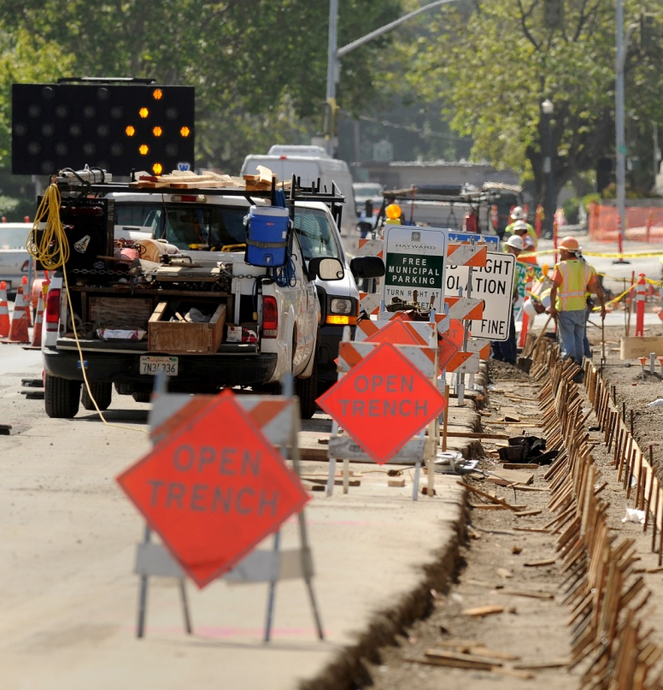
3. All Projects/Phases
[Insert language from your resolution that addresses this element.]

Slide 20

4. Exceptions
[Insert language from your resolution that addresses this element.]
Notes:
Image source: Open Clip Art Library

Slide 21
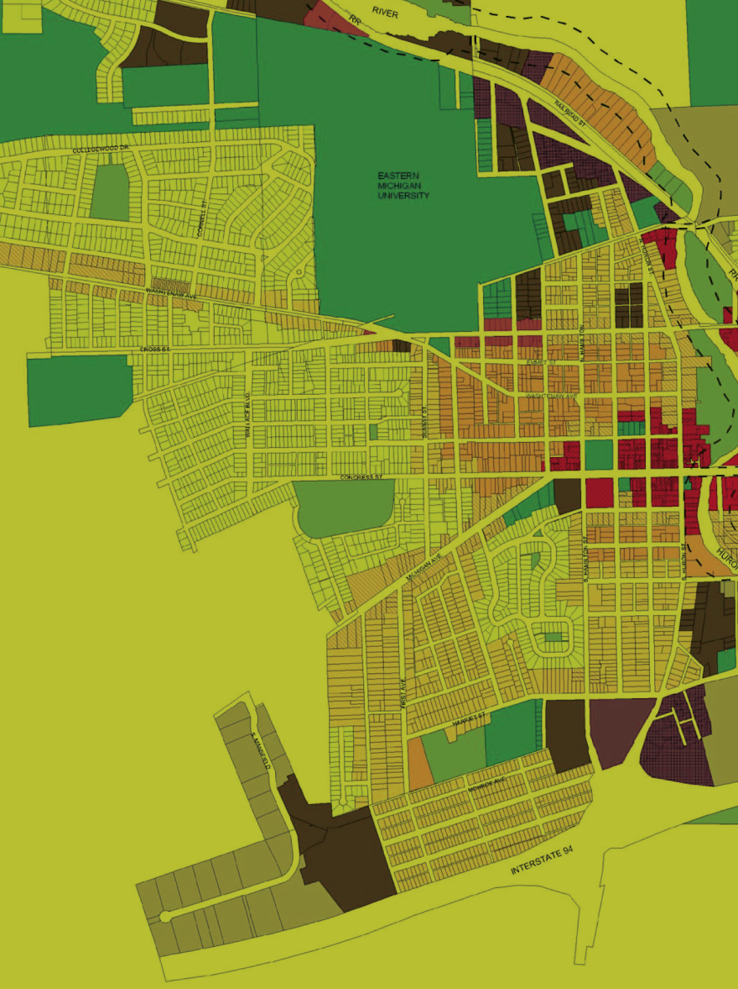
5. Network/Connectivity
[Insert language from your resolution that addresses this element.]

Slide 22
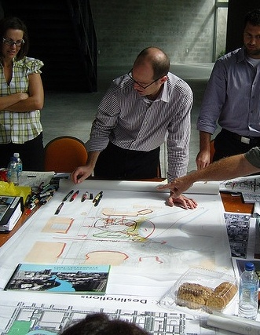
6. Jurisdiction
[Insert language from your resolution that addresses this element.]

Slide 23
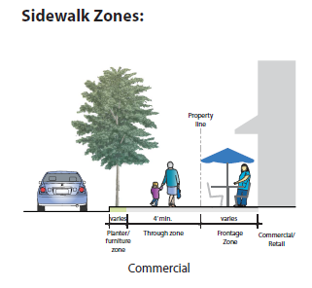
7. Design
[Insert language from your resolution that addresses this element.]

Slide 24
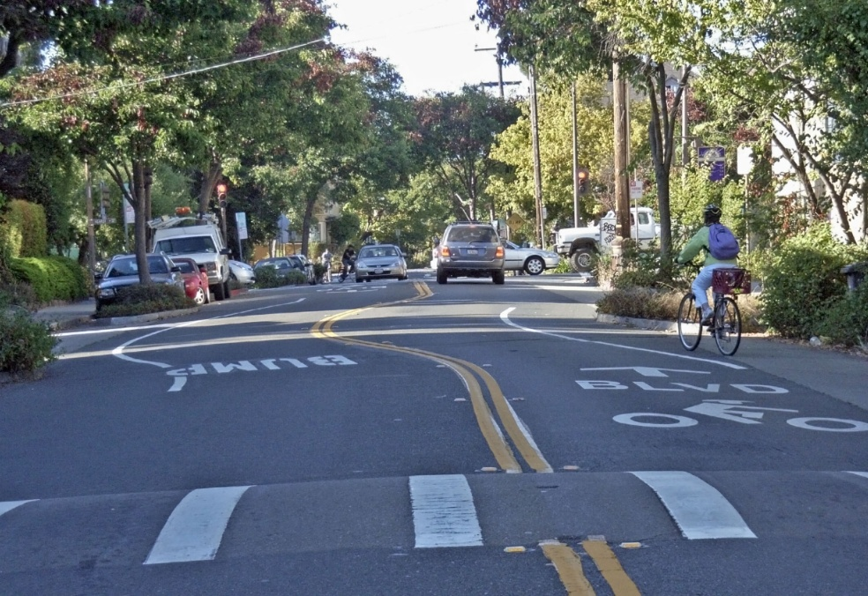
8. Context Sensitivity
[Insert language from your resolution that addresses this element.]

Slide 25
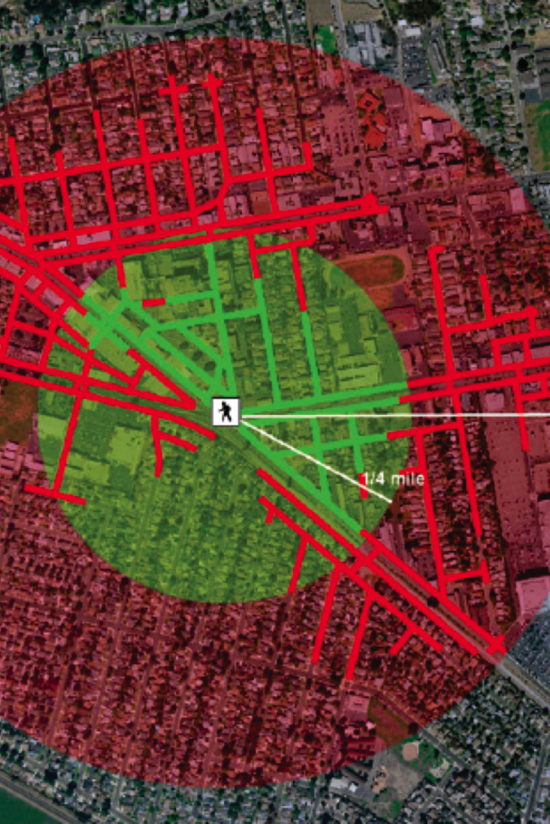


9. Performance Measures
[Insert language from your resolution that addresses this element.]
Actual 5 min. walk (1/4 mi)
Actual 10 min. walk (1/2 mi)

Slide 26
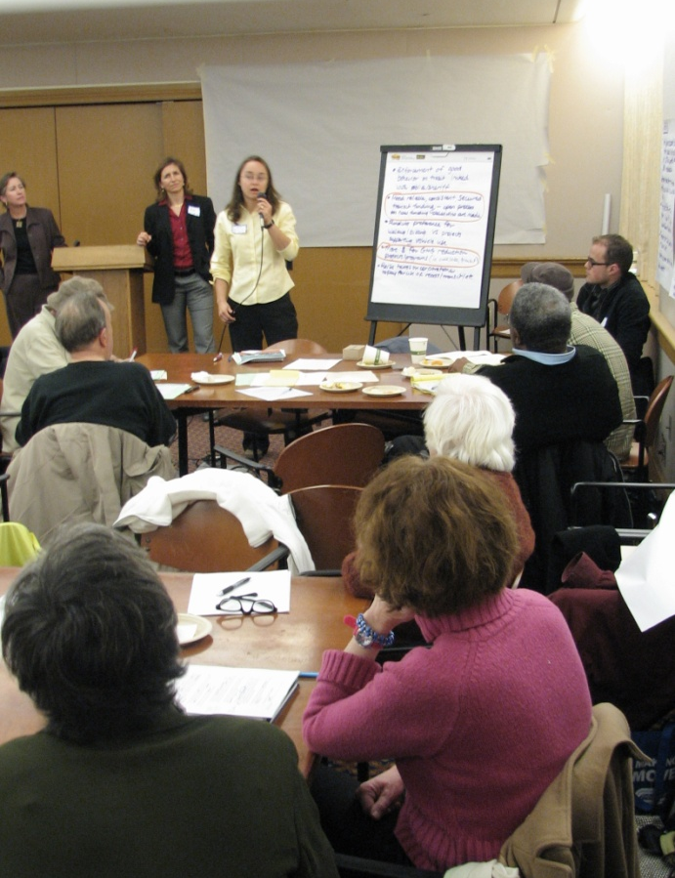
10. Implementation Next Steps
[Insert language from your resolution that addresses this element.]

Slide 27
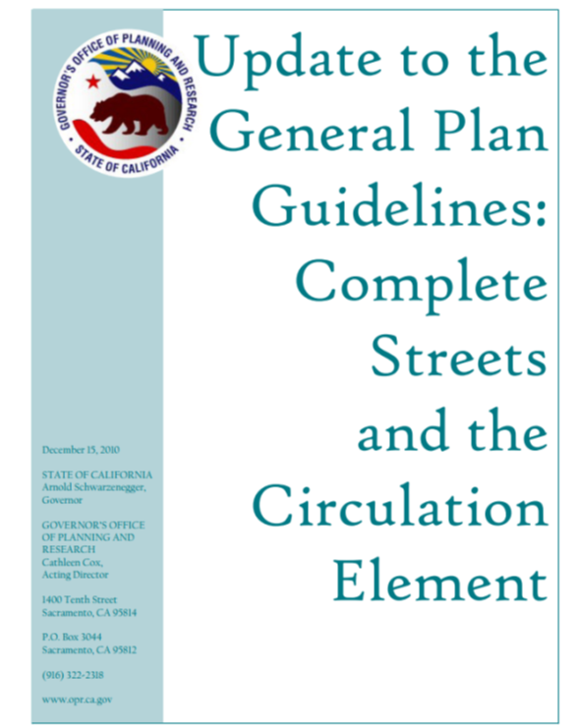
Next Steps
Implementing our Complete Streets Policy
  [insert local next steps]
  [insert local next steps]
General Plan Amendment
  State, regional, and county requirements
  Late 2014 deadline for OBAG funding
Actual 5 min. walk (1/4 mi)
Actual 10 min. walk (1/2 mi)

Slide 28
Resources for Locals
MTC is offering workshop on policy development and implementation
Alameda CTC
  Local tools and sample documents
  Complete Streets resources web page
  Additional support under development
Notes:
Alameda CTC resources web page:
http://www.alamedactc.org/app_pages/view/8564

Slide 29
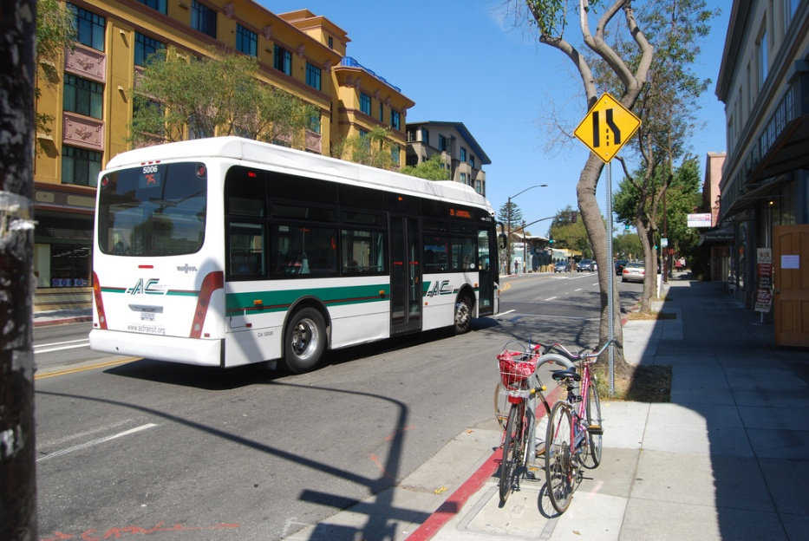
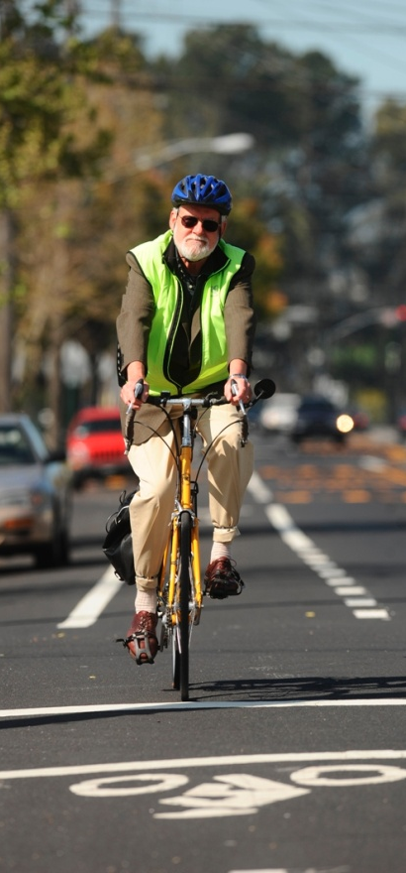
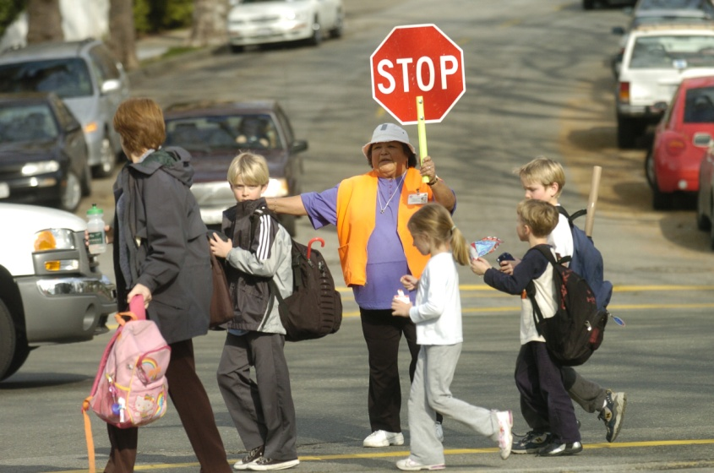
Questions?

Slide 30
Sources
National Complete Streets Coalition and Local Government Commission. 2012. Complete Streets in California: It’s a Safe Decision.
Lawrence Frank and Company, Inc. 2005. A Study of Land Use, Transportation, Air Quality, and Health (LUTAQH) in King County, WA.
Los Angeles County Metropolitan Transportation Authority. 2002. Metro Rapid Demonstration Program, Final Report.
Giles-Corti, B., & R.J. Donovan. 2002. The relative influence of individual, social, and physical environment determinants of physical activity. Social Science & Medicine, 54 1793-1812.
Dill, J. & T. Carr. (2003). Bicycle Commuting and Facilities in Major US Cities: If You Build Them, Commuters Will Use Them. Transportation Research Record:, No. 1828, TRB, pp 116-123.
National Highway Traffic Safety Administration’s National Center for Statistics and Analysis. 2009. Traffic Safety Facts: 2008 Overview.
Surface Transportation Policy Project. 2004. Aging Americans: Stranded Without Options.
Ashmead, D.H., et al. 2005. Street Crossing by Sighted and Blind Pedestrians at a Modern Roundabout. Journal of Transportation Engineering, 131 (11): 812-821.
Bay Area Air Quality Management District. 2007. Source Inventory of Greenhouse Gas Emissions.
Pucher, J. 2009. Walking and Cycling: Path to Improved Public Health. Fit City Conference, NYC.
National Association for Sport and Physical Education. 2010. Shape of the Nation Report.

