Slide 1

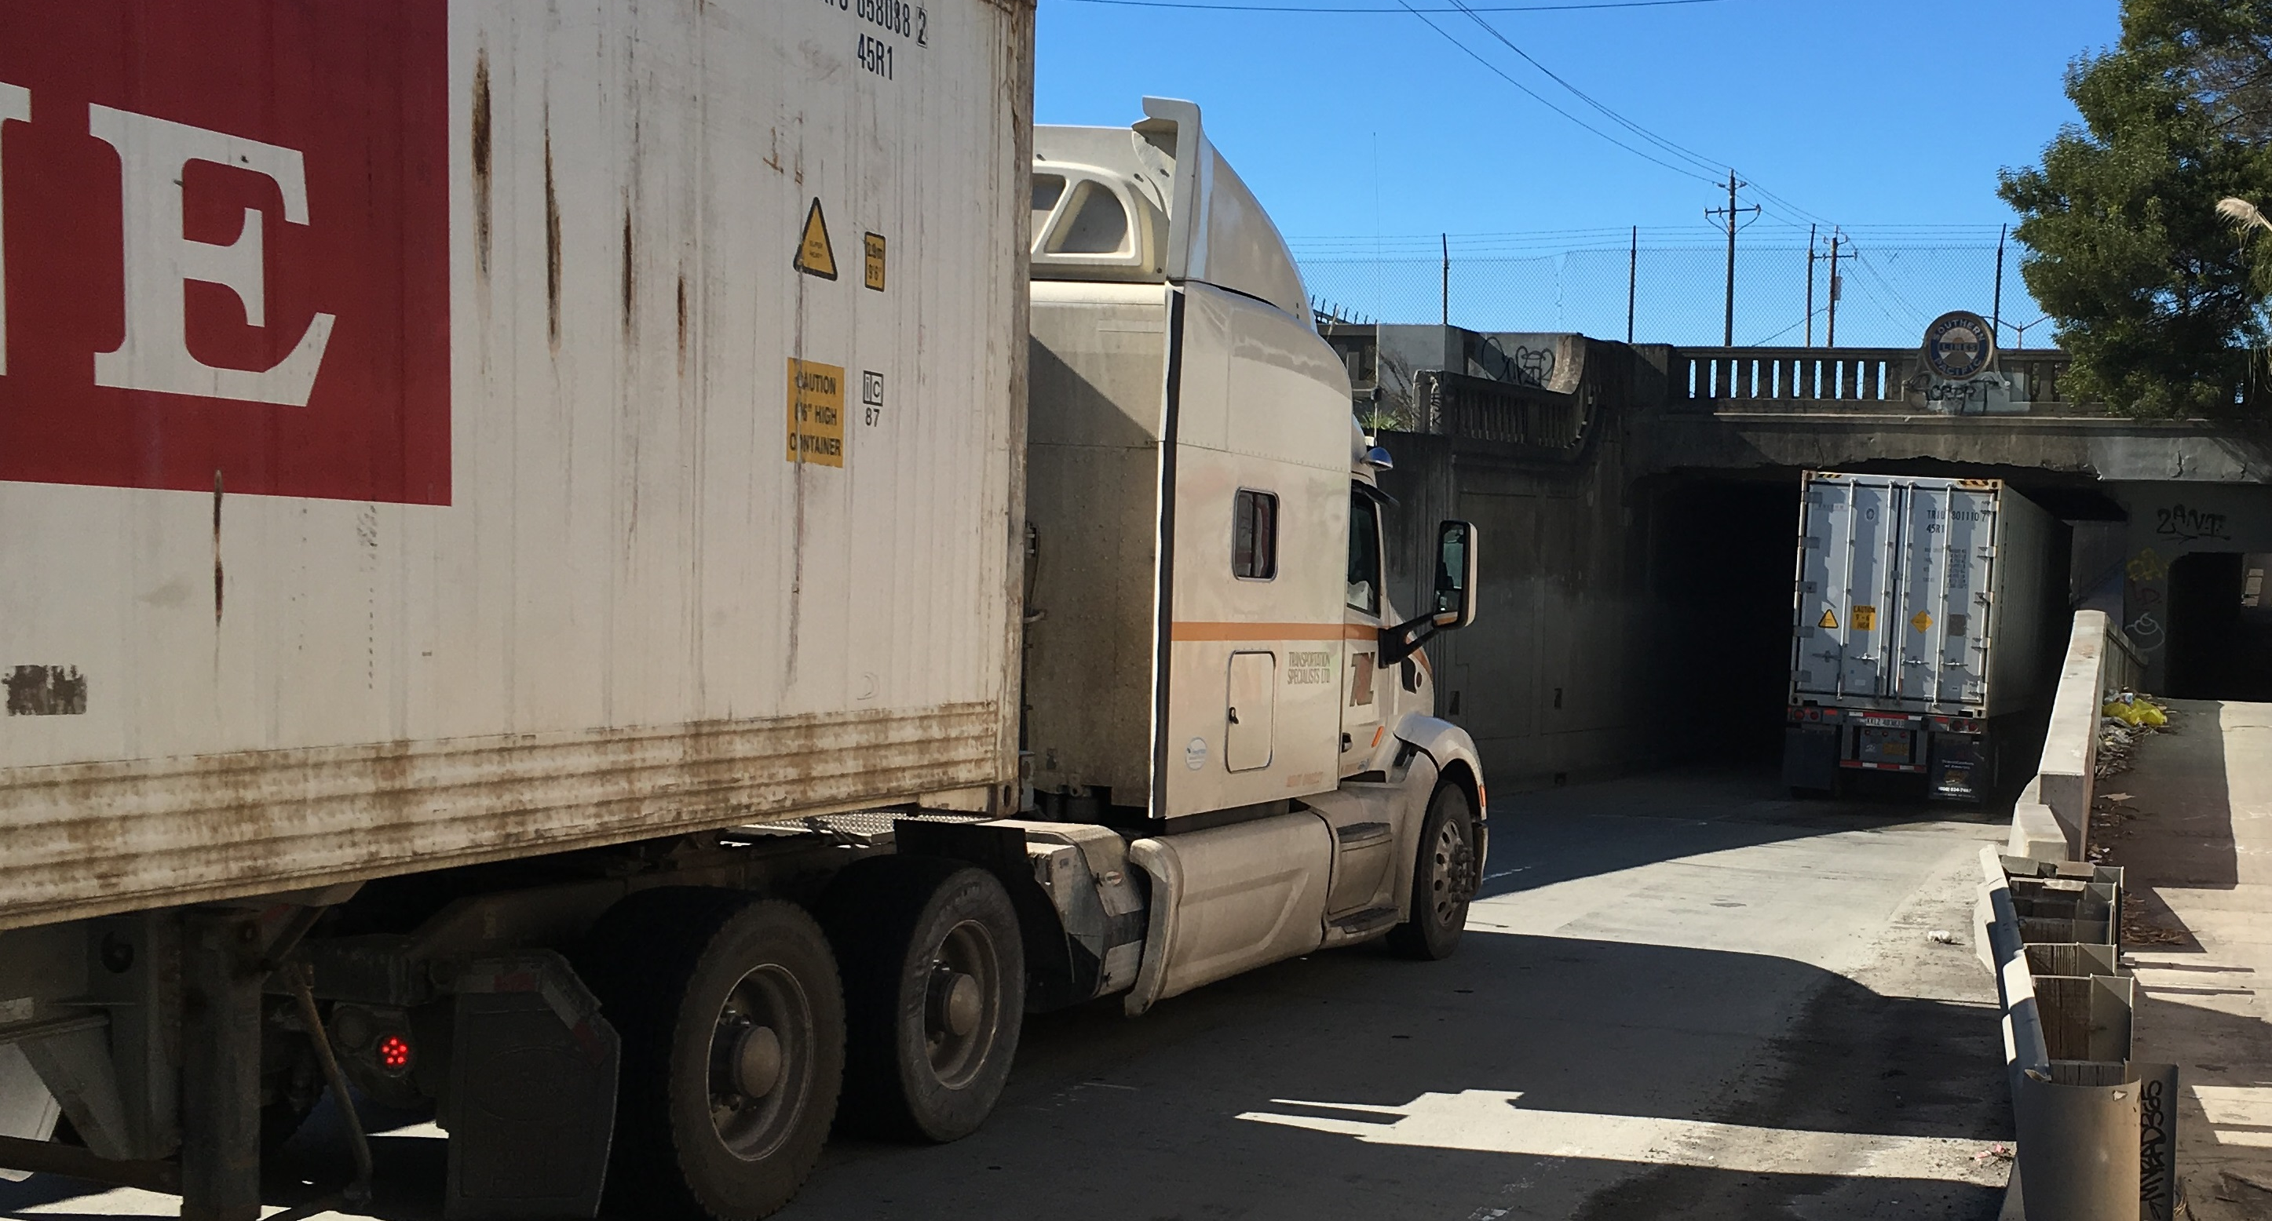
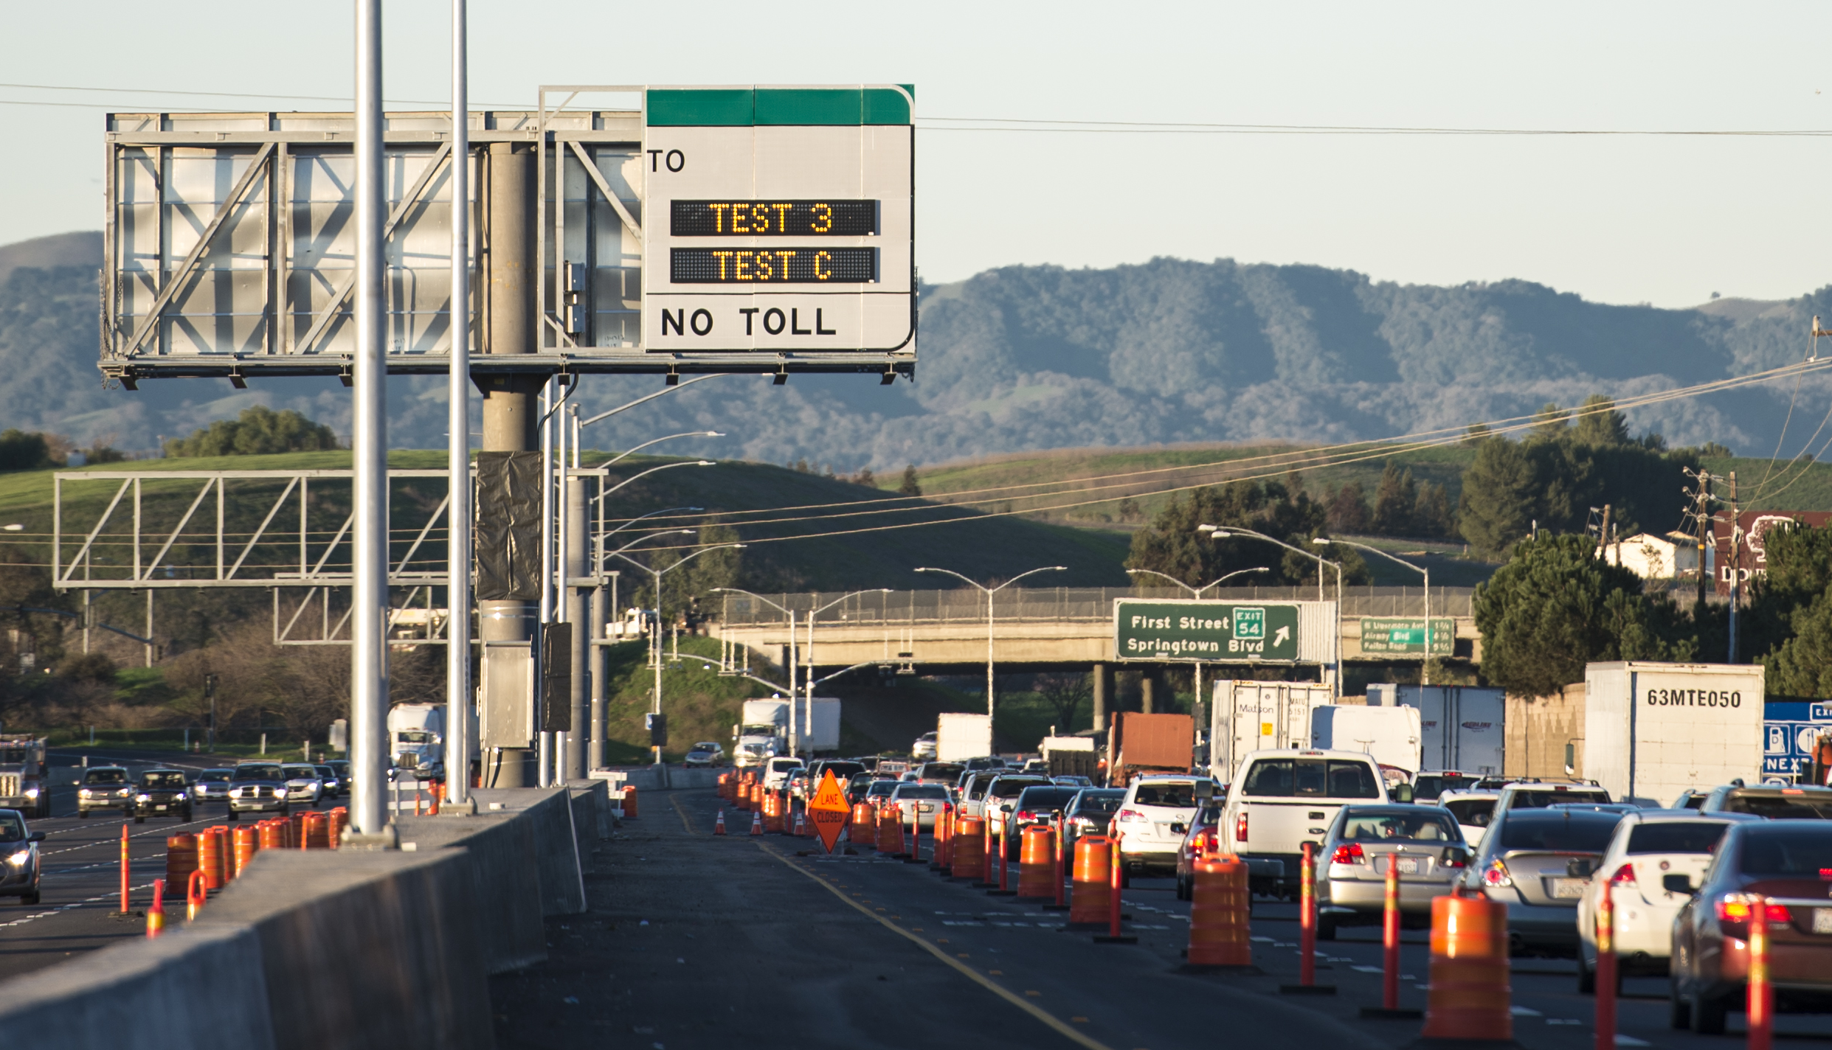
Alameda CTC
Comprehensive Investment Plan 2016 Update
Prepared for the Alameda CTC Commission March 2016

Slide 2
Alameda CTC Comprehensive Investment Plan (CIP) Overview
Single document summarizing the Programming and Allocation actions approved by the Alameda CTC
Five-Year programming horizon and Two-Year Allocation Plan
Candidate list of programs and projects based on Countywide Transportation Plan (CTP) updates
CIP updated every two years to add two new years to the five-year horizon
CIP updated annually to reflect current status of programs, projects and funding
Annual updates satisfy Expenditure Plan requirements for Strategic Plan updates
Notes:
2

Slide 3
Alameda CTC CIP Update Timeline
Notes:
3

Slide 4
Alameda CTC CIP 2016 Update
List of Programs and Projects
Measure BB funding is the only new funding added in the CIP 2016 Update
$47 million of Measure BB allocated in the FY 15/16 CIP still active
2016 CIP Update adds programming of $217 million of Measure BB to the 5-Yr horizon of the FY 15/16 CIP
2016 CIP Update adds allocations of $138 million of Measure BB in FY’s 15/16 & 16/17 to 28 programs and projects
Program and project list based on readiness and priorities determined by the CTP, Countywide Modal Plans, and coordination with local agencies
Notes:
4

Slide 5
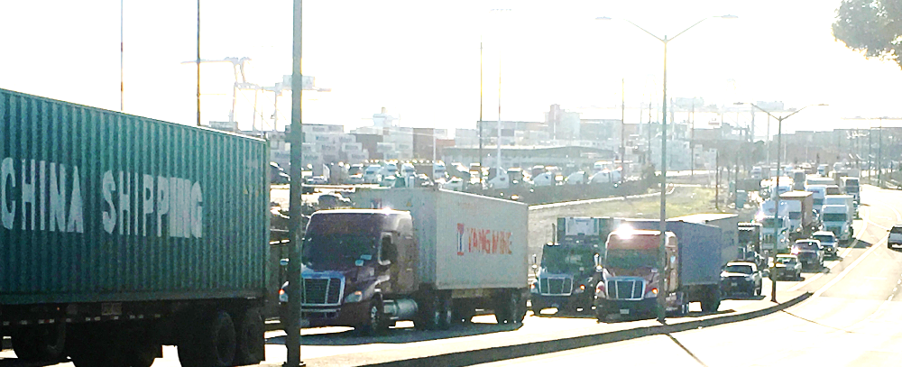
Alameda CTC CIP 2016 Update
List of Programs and Projects
Project development for freight-related programs and projects recommended for pursuit of State and Federal funding (Call for Projects already issued)
Multi-modal corridor studies for major arterial corridors to identify prioritized list of specific improvements for implementation
CIP 2016 Update Includes programs and projects from Alameda CTC Capital Project Delivery Plan (CPDP) as approved by the Alameda CTC
Notes:
5

Slide 6
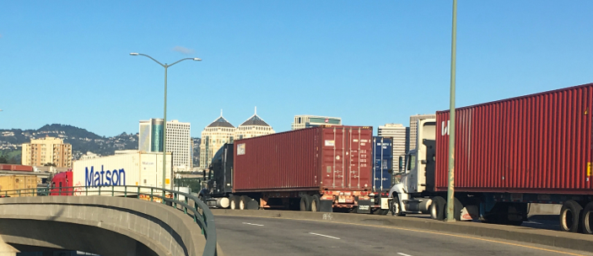

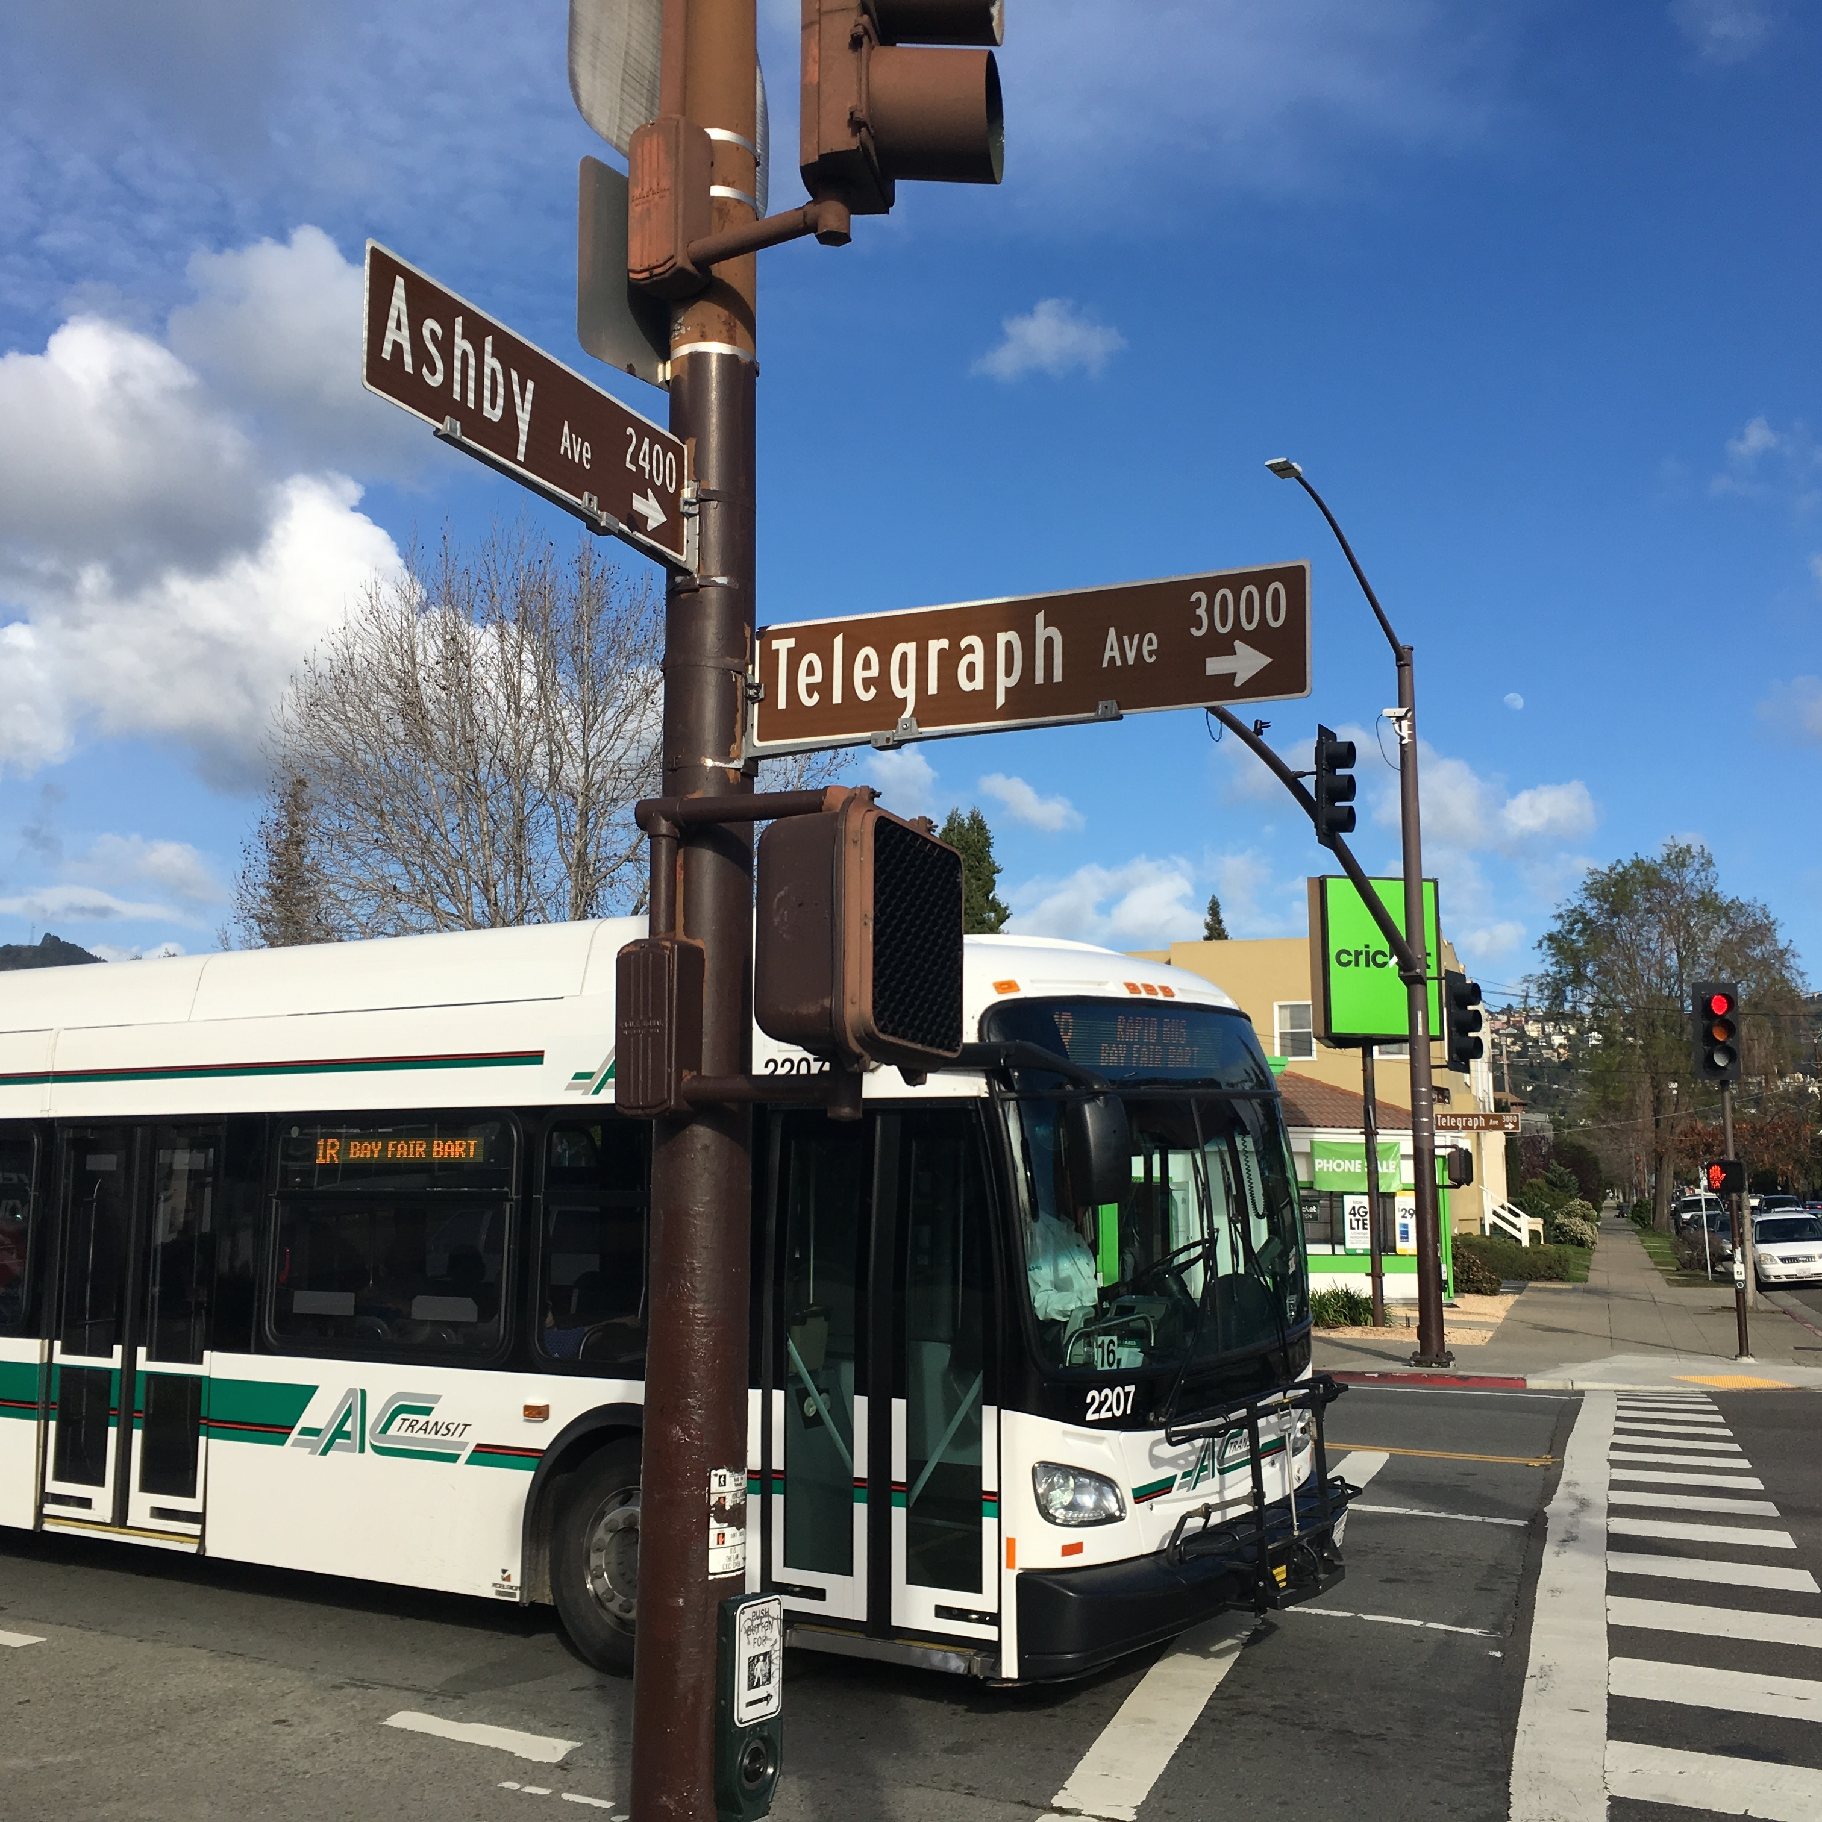
Alameda CTC CIP 2016 Update
Programming Principles and Assumptions
Purpose of the 2016 CIP Update
  Changes to 5-Year programming horizon of FY 15/16 CIP
  Satisfy Strategic Plan requirements for voter-approved Measures
Incorporation of long- and near-term planning efforts
Updating Revenue Forecast for fund sources
Notes:
6

Slide 7

Alameda CTC CIP 2016 Update
Programming Principles and Assumptions
Programming and Allocation Requirements
  Program/Project definition by Phase
  Cost-sharing arrangements and eligible costs
    Staff time, oversight, permit fees, etc. for Direct Local Distribution recipients not eligible for program/project allocations
  Allocations by Phase
    Risk sharing for allocations with additional risk
  Retroactive allocations acknowledged at time of allocation
  Alameda CTC Local Business Contract Equity Program
Notes:
7

Slide 8
Alameda CTC CIP 2016 Update
Next Steps
Alameda CTC Approve CPDP (March 2016)
Alameda CTC Approve CIP 2016 Update (May 2016)
Alameda CTC Issues Request for Proposals for program and project phases directly implemented by the Alameda CTC (from CPDP)
Alameda CTC Execute Funding Agreements with Local Sponsors
Notes:
8

Slide 9
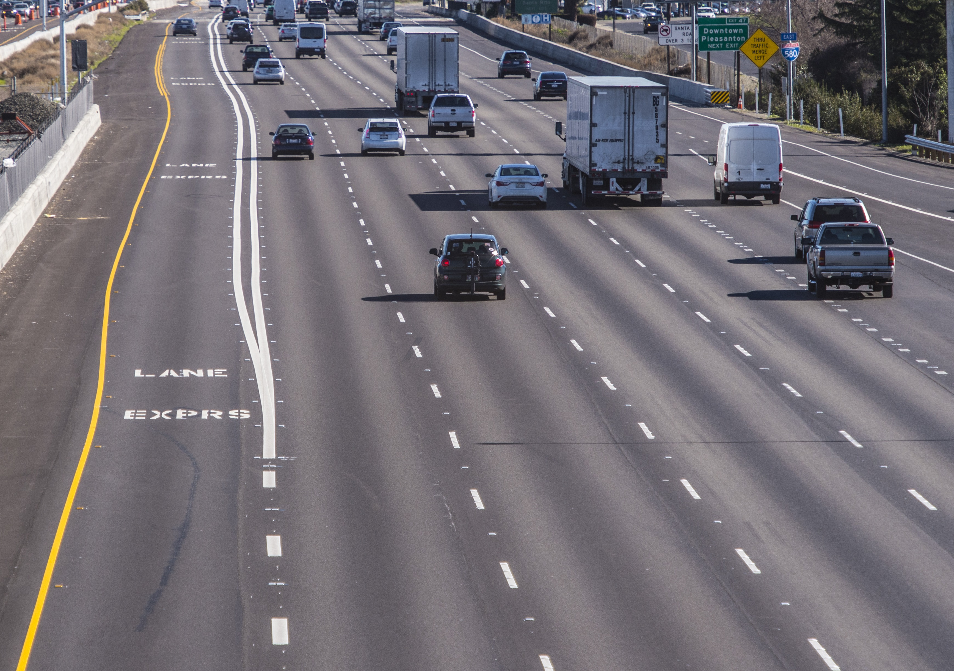
Questions/Answers
Notes:
9

